Slide 1


Long read Assembly

Slide 2
Outline
The main protocols for long read technologies
The error profile of long reads
Methods of read correction
Correction with short reads
Correction using long reads
Assembly Tools
Assembly Diagnostics
Assembly Polishing

Slide 3
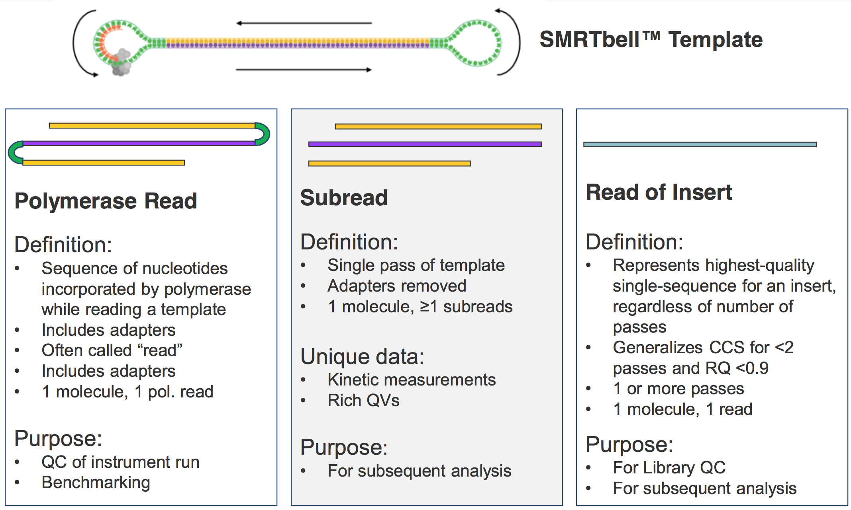
Pacific Biosciences

Slide 4
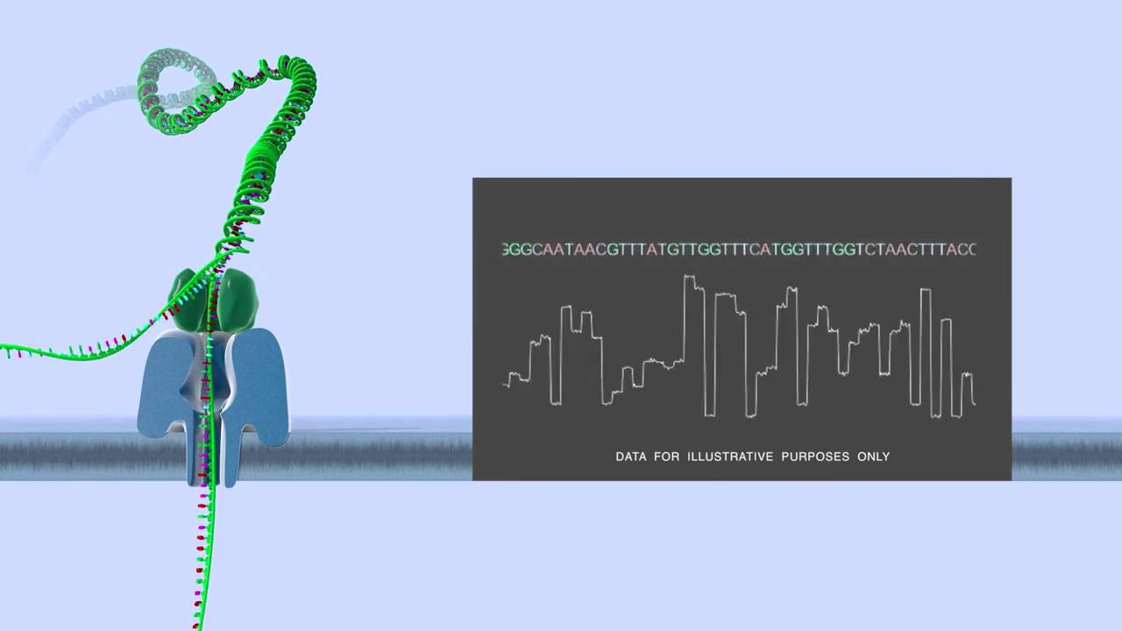
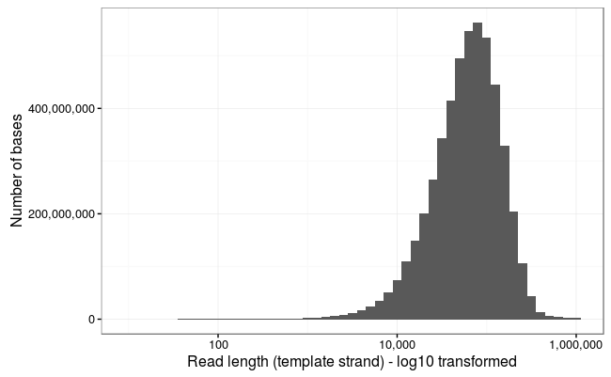
Oxford Nanopore
Loman lab

Slide 5
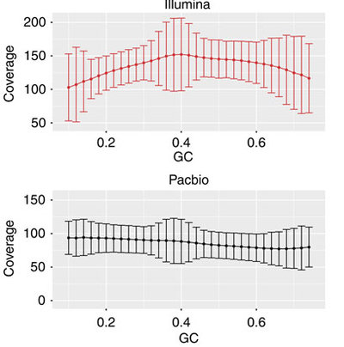
Short read GC Bias
Shi et al. 2016. Nature Communications.

Slide 6
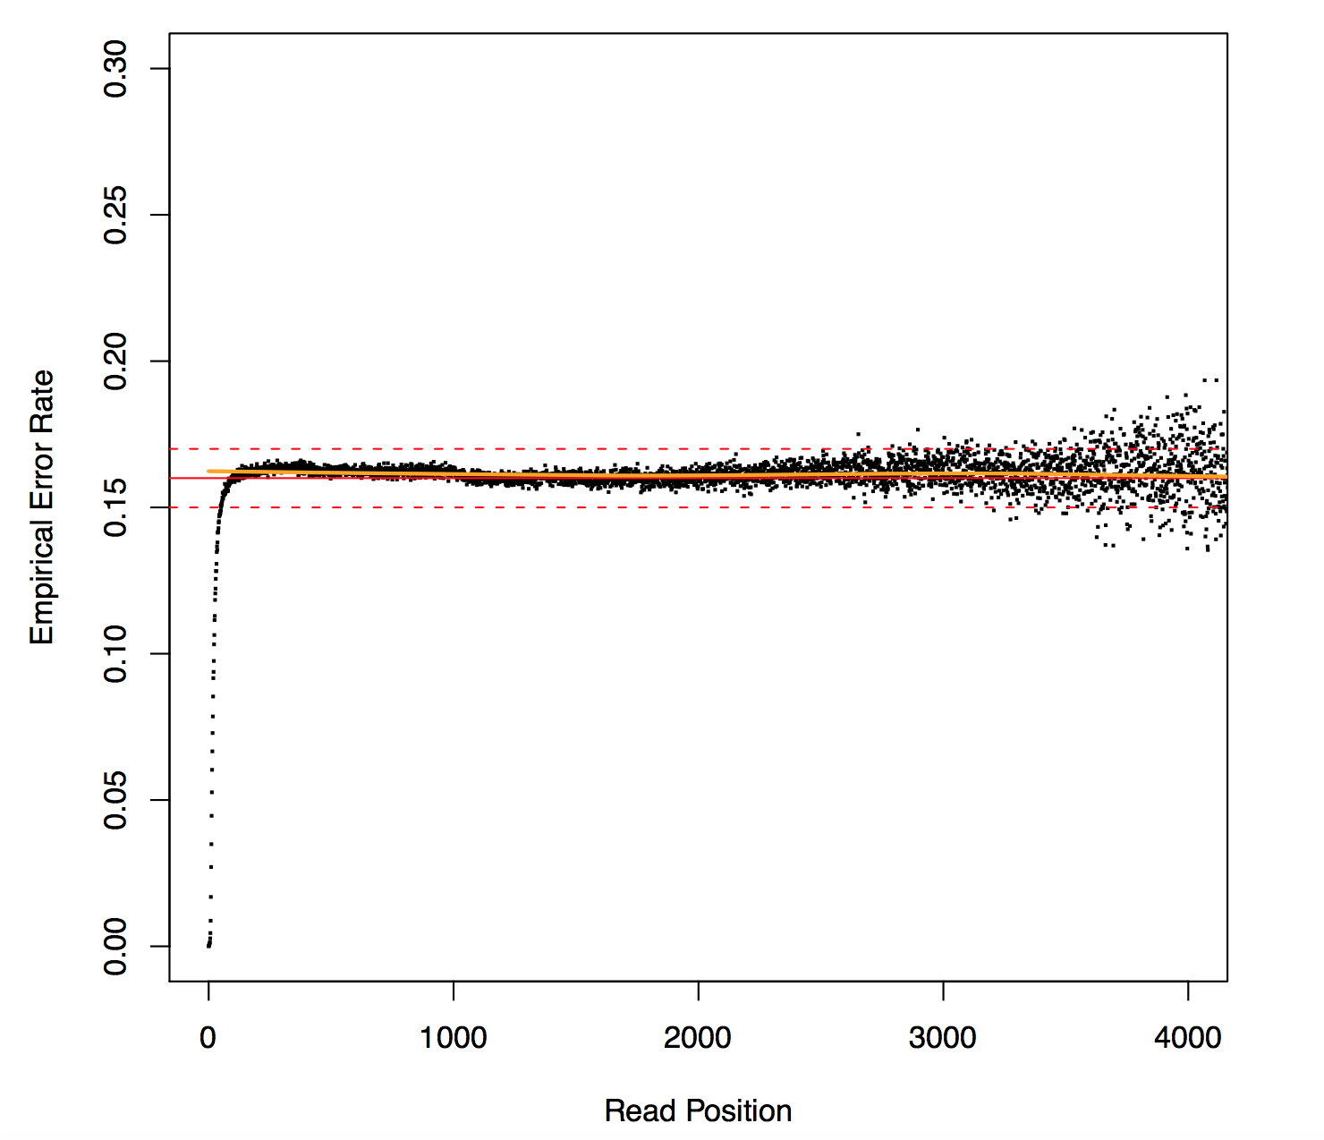
PacBio Error Profile
Koren et al. 2012. Nature Biotechnology.

Slide 7
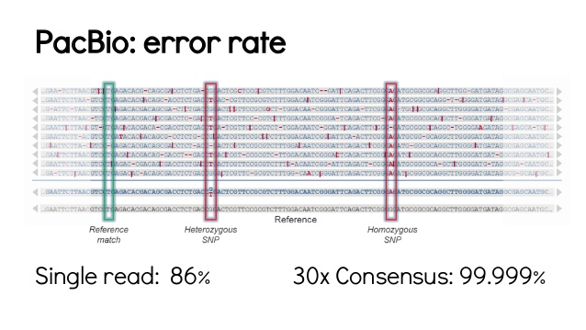
PacBio Error Profile
T. Seemann. 2015: slideshare.net: Long read sequencing

Slide 8
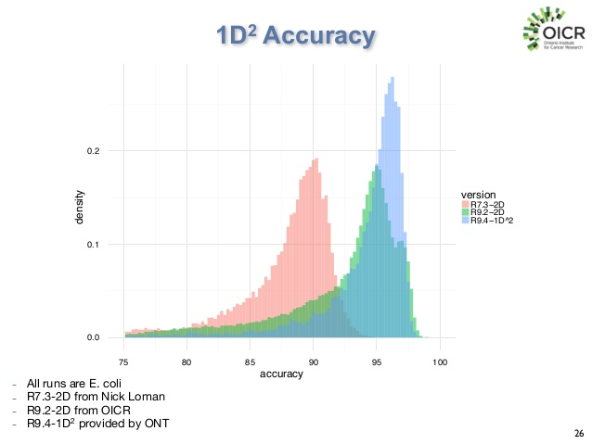
Nanopore error rate
Jared Simpson: AGBT presentation

Slide 9
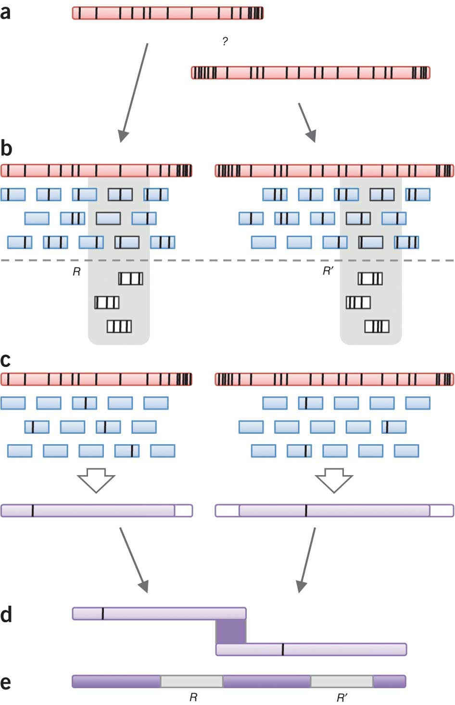
Read Correction
Correction using Illumina reads
Homopolymer correction, point mutations, and indels
Doesn’t correct structural errors
Tools
PBcR / PacBioToCA
LSC / LSCplus
LoRDEC (de Bruijn graph)
Proovread
ECTools
Jabba (de Bruijn graph)
Koren et al. 2012. Nature Biotechnology.

Slide 10
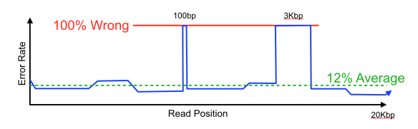
Read Correction
Structural errors
Chimeric reads ( see Tallon et al. 2014. BMC Genomics)
Missed or incorrectly inferred adapter
Interference from other molecules
…
G. Myers. 2015. Dazzlerblog.wordpress.com. Intrinsic Quality Values

Slide 11
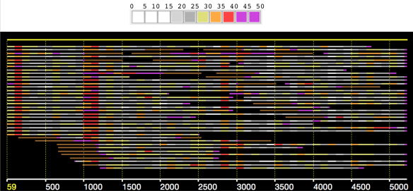
Read Correction
Likely wrong sequence
Differences per 100bp segment

Slide 12
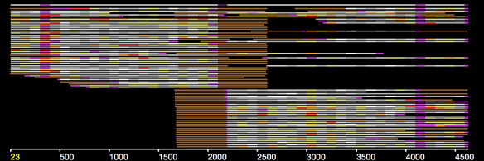
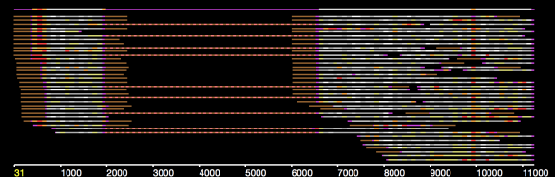
Read Correction
Missing sequence? Chimer? Break read
Inserted sequence from Chimer?

Slide 13
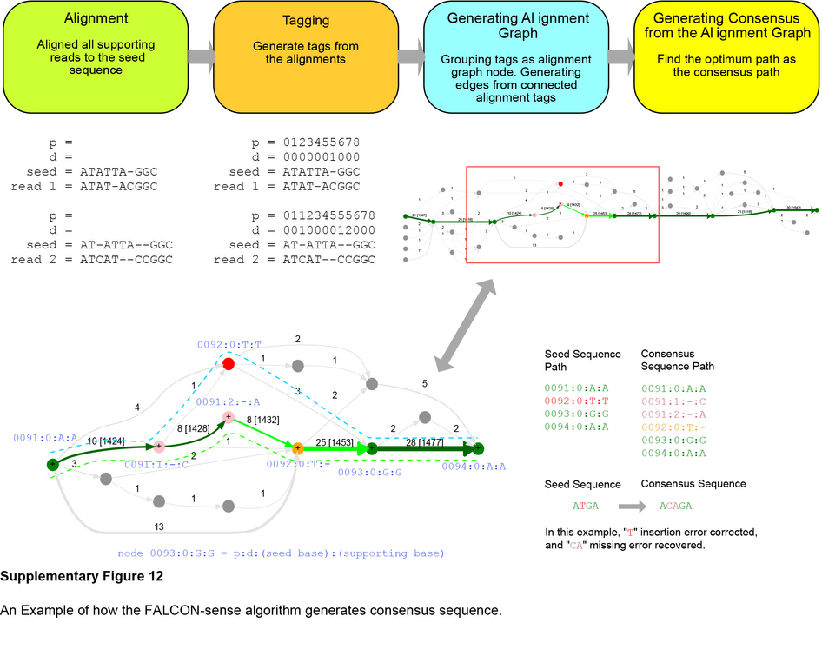
Read Correction
Use a weighted directed acyclic graph to find consensus sequence
Chin et al. 2016. Nature Methods

Slide 14
Read Assembly
Popular long read assemblers:
HGAP (PacBio)
Limited to genomes < 200MB
http://www.pacb.com/support/software-downloads/
Canu (PacBio, Nanopore)
Any size genome
https://github.com/marbl/canu
Falcon (PacBio, Nanopore?)
Small and medium sized genomes, Diploid aware
http://pb-falcon.readthedocs.io/en/latest/
Miniasm (PacBio, Nanopore)
Any size genomes
https://github.com/lh3/miniasm

Slide 15
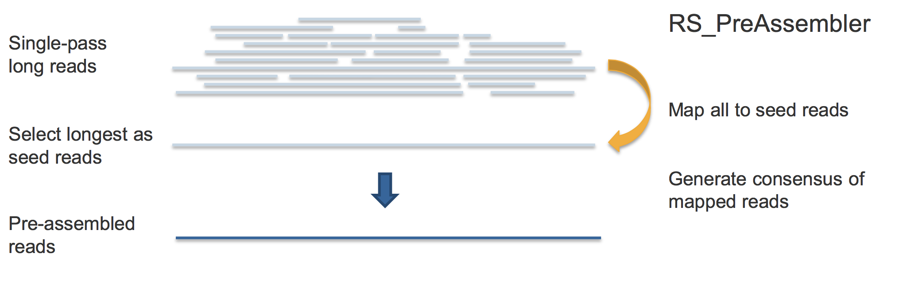
HGAP
Slides from PacBio: BFX_Workshop_Oct_2014_Final-lh.pdf

Slide 16
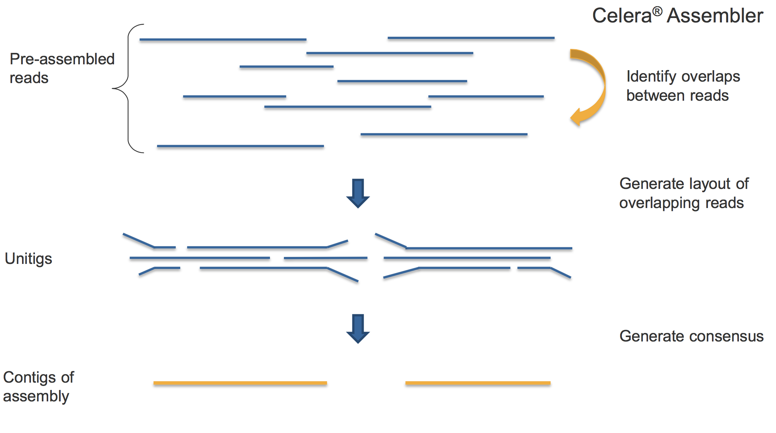
HGAP

Slide 17
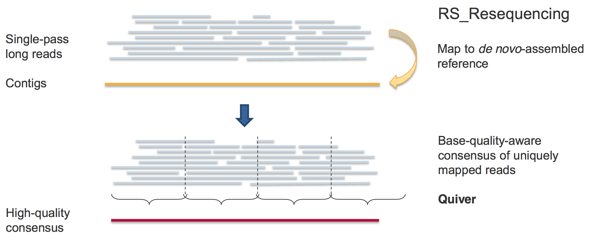
HGAP

Slide 18
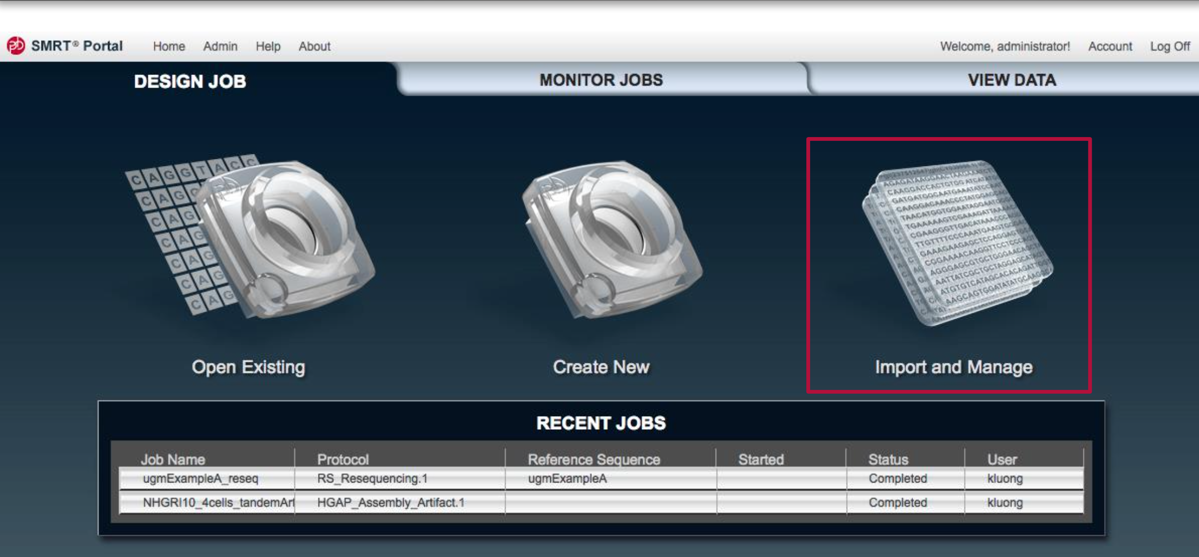
HGAP

Slide 19
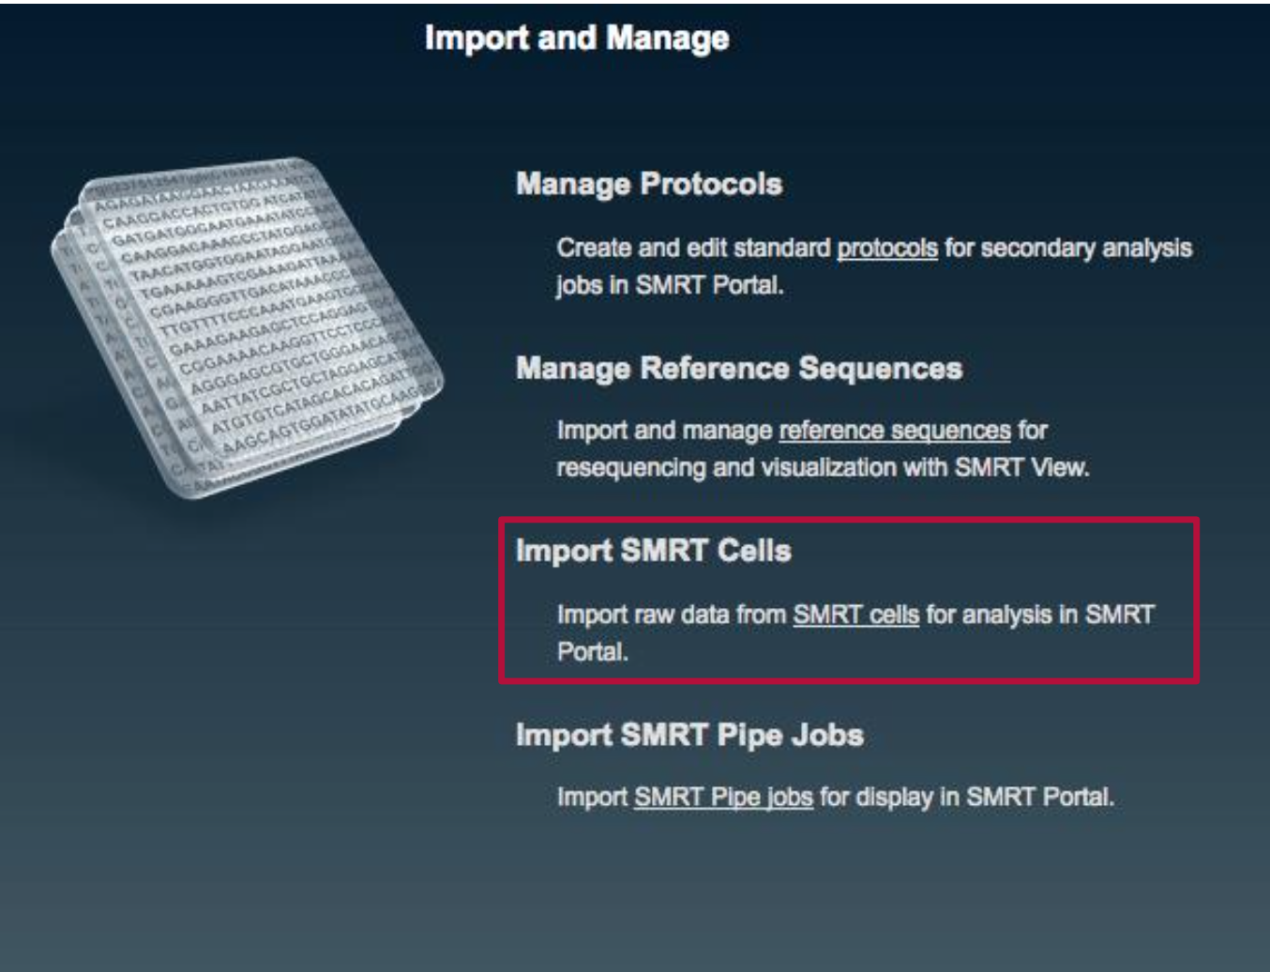
HGAP

Slide 20
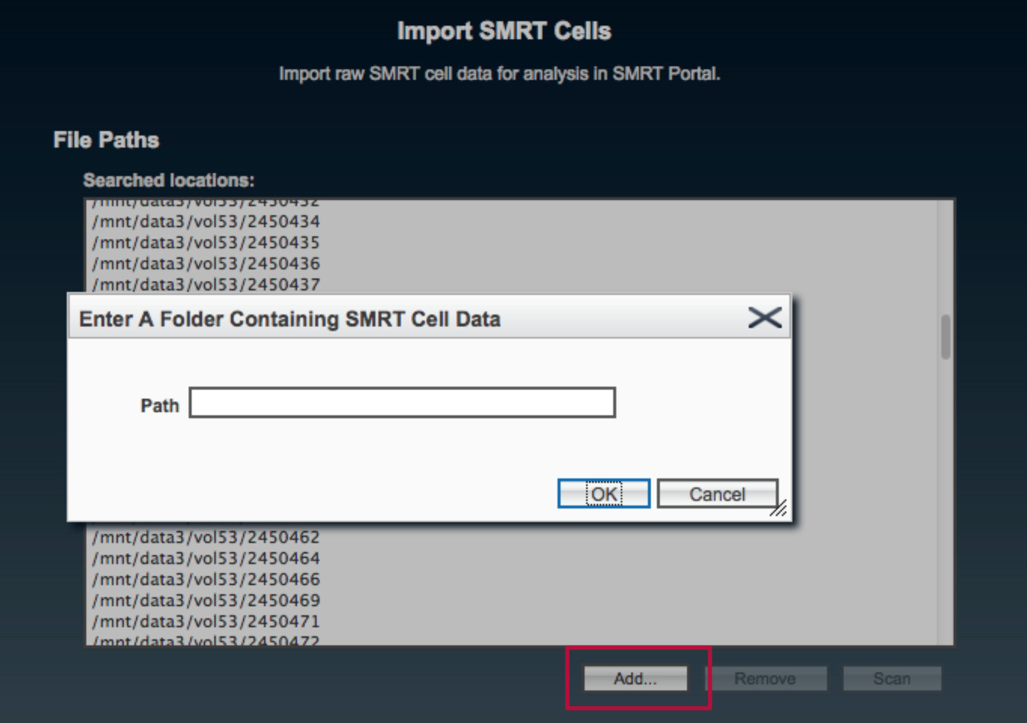
HGAP

Slide 21
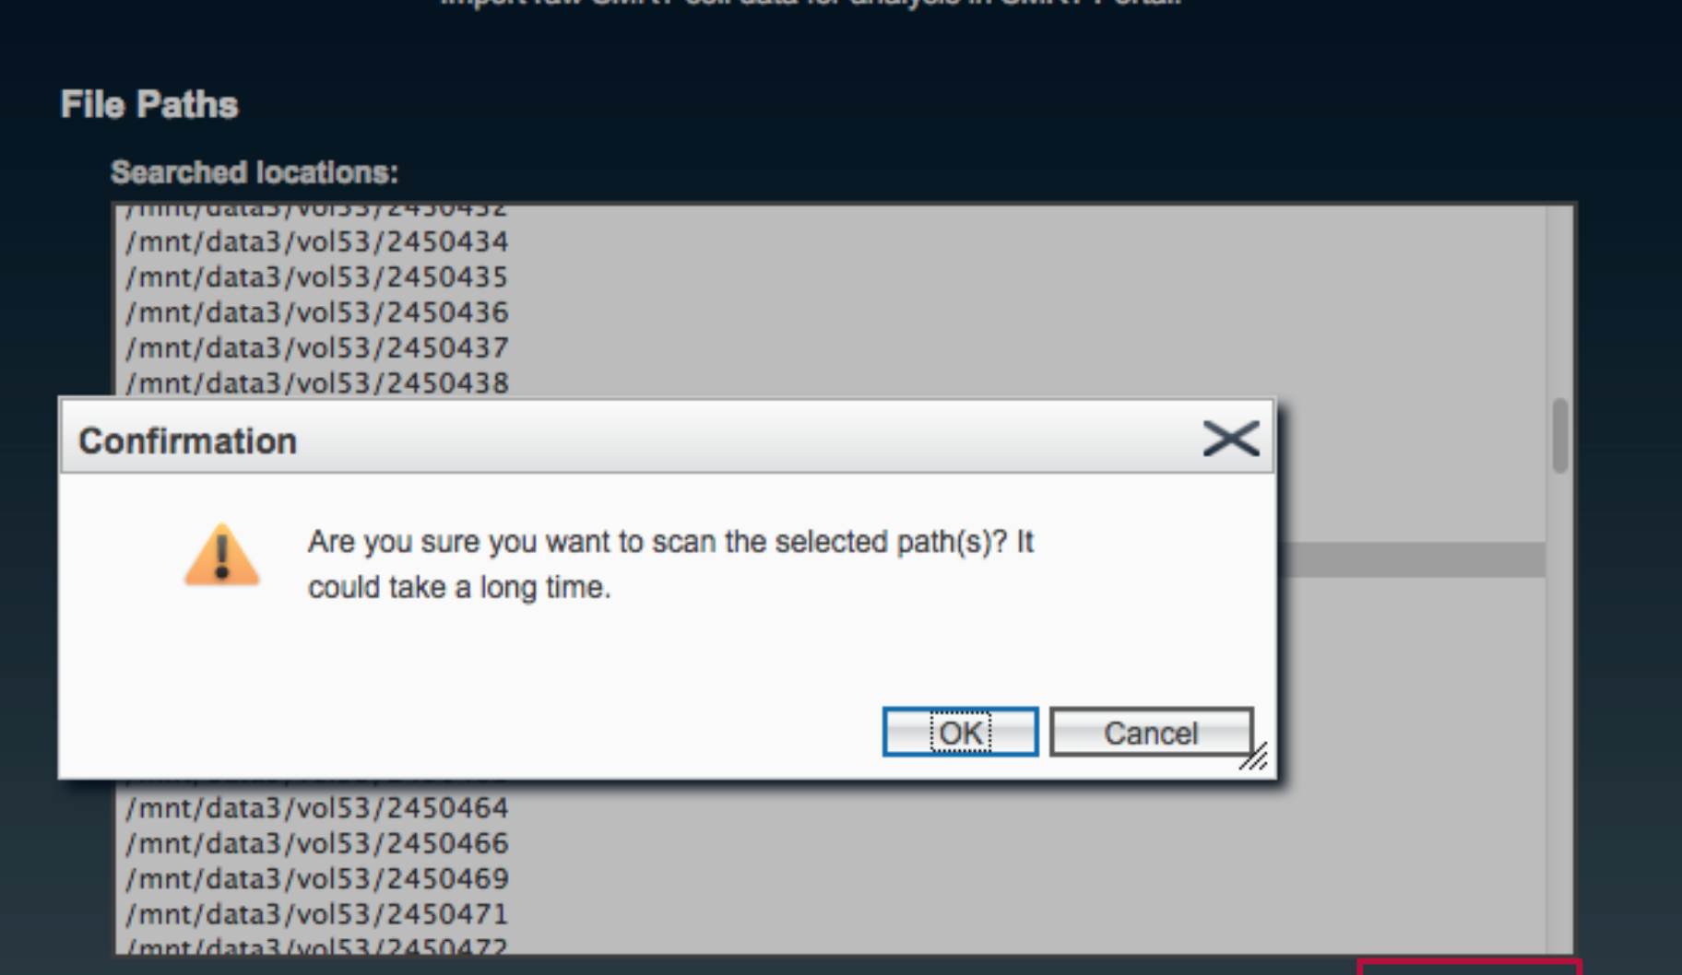
HGAP

Slide 22
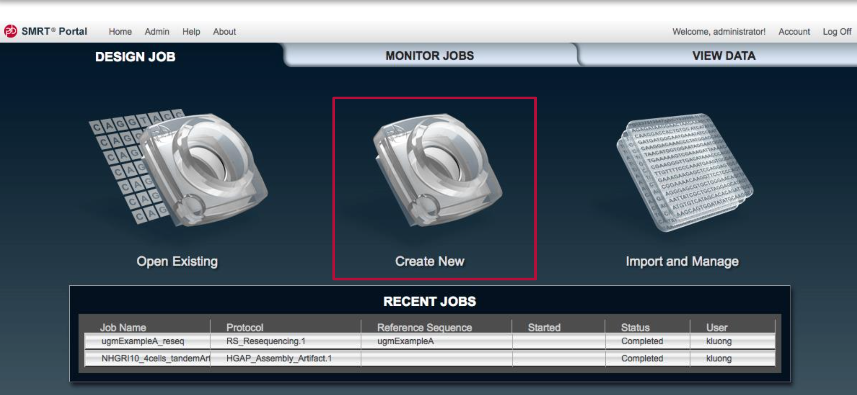
HGAP

Slide 23
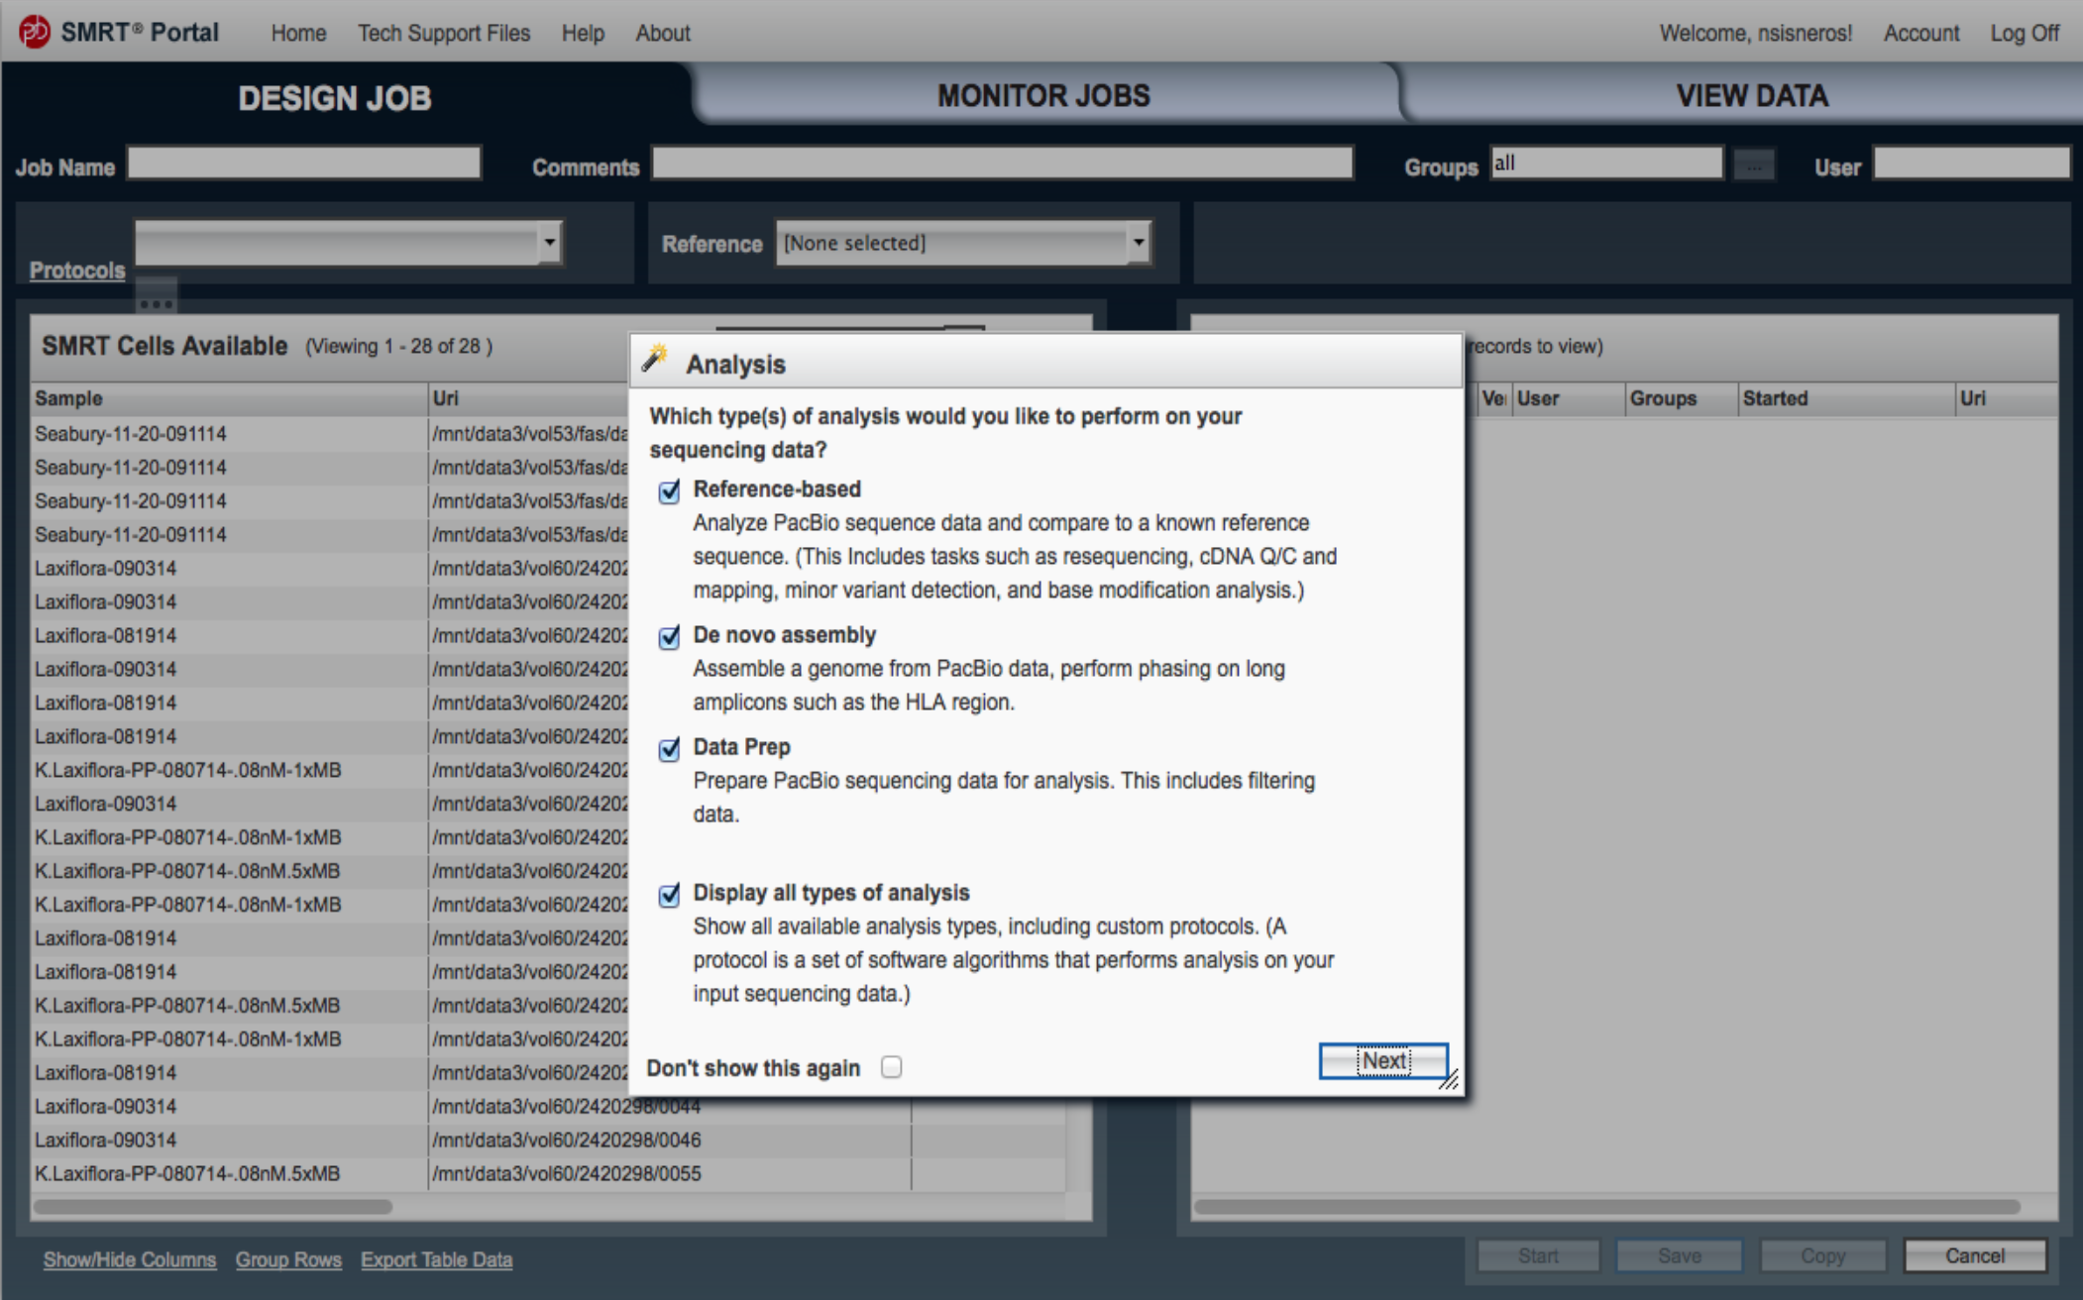
HGAP

Slide 24
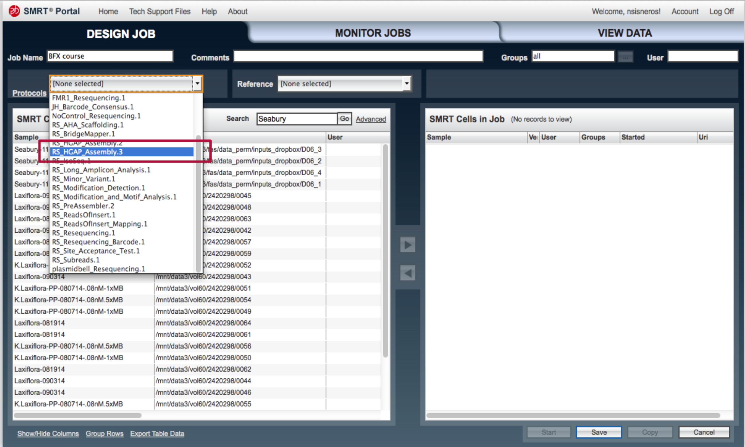
HGAP

Slide 25
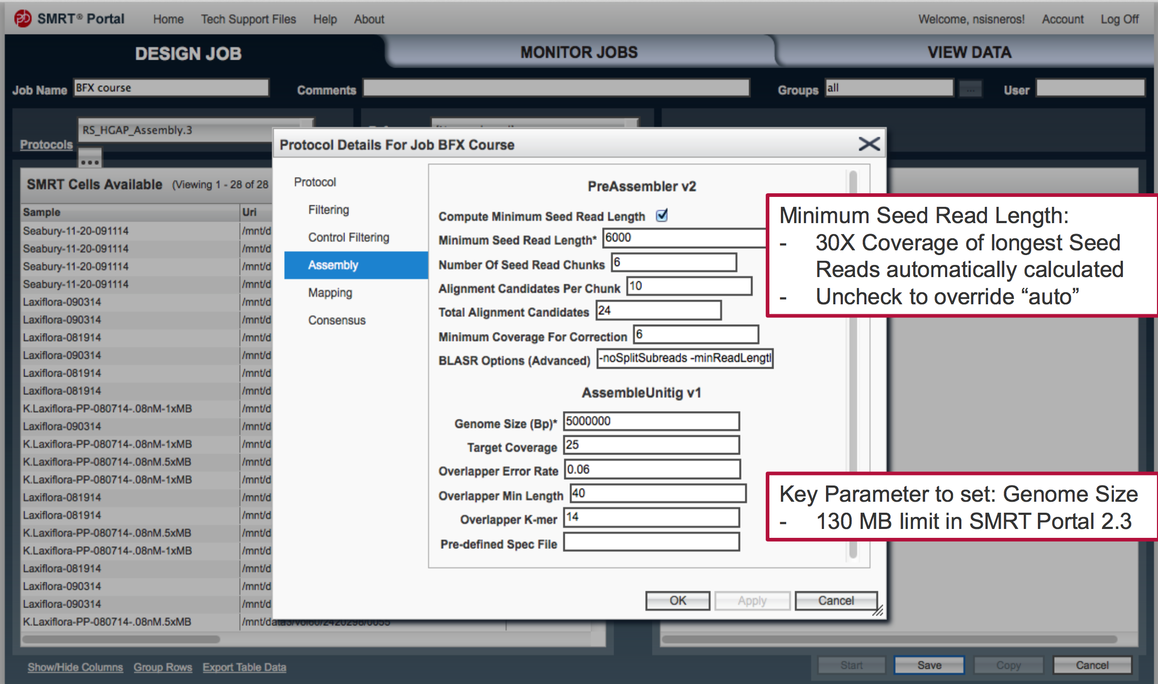
HGAP

Slide 26
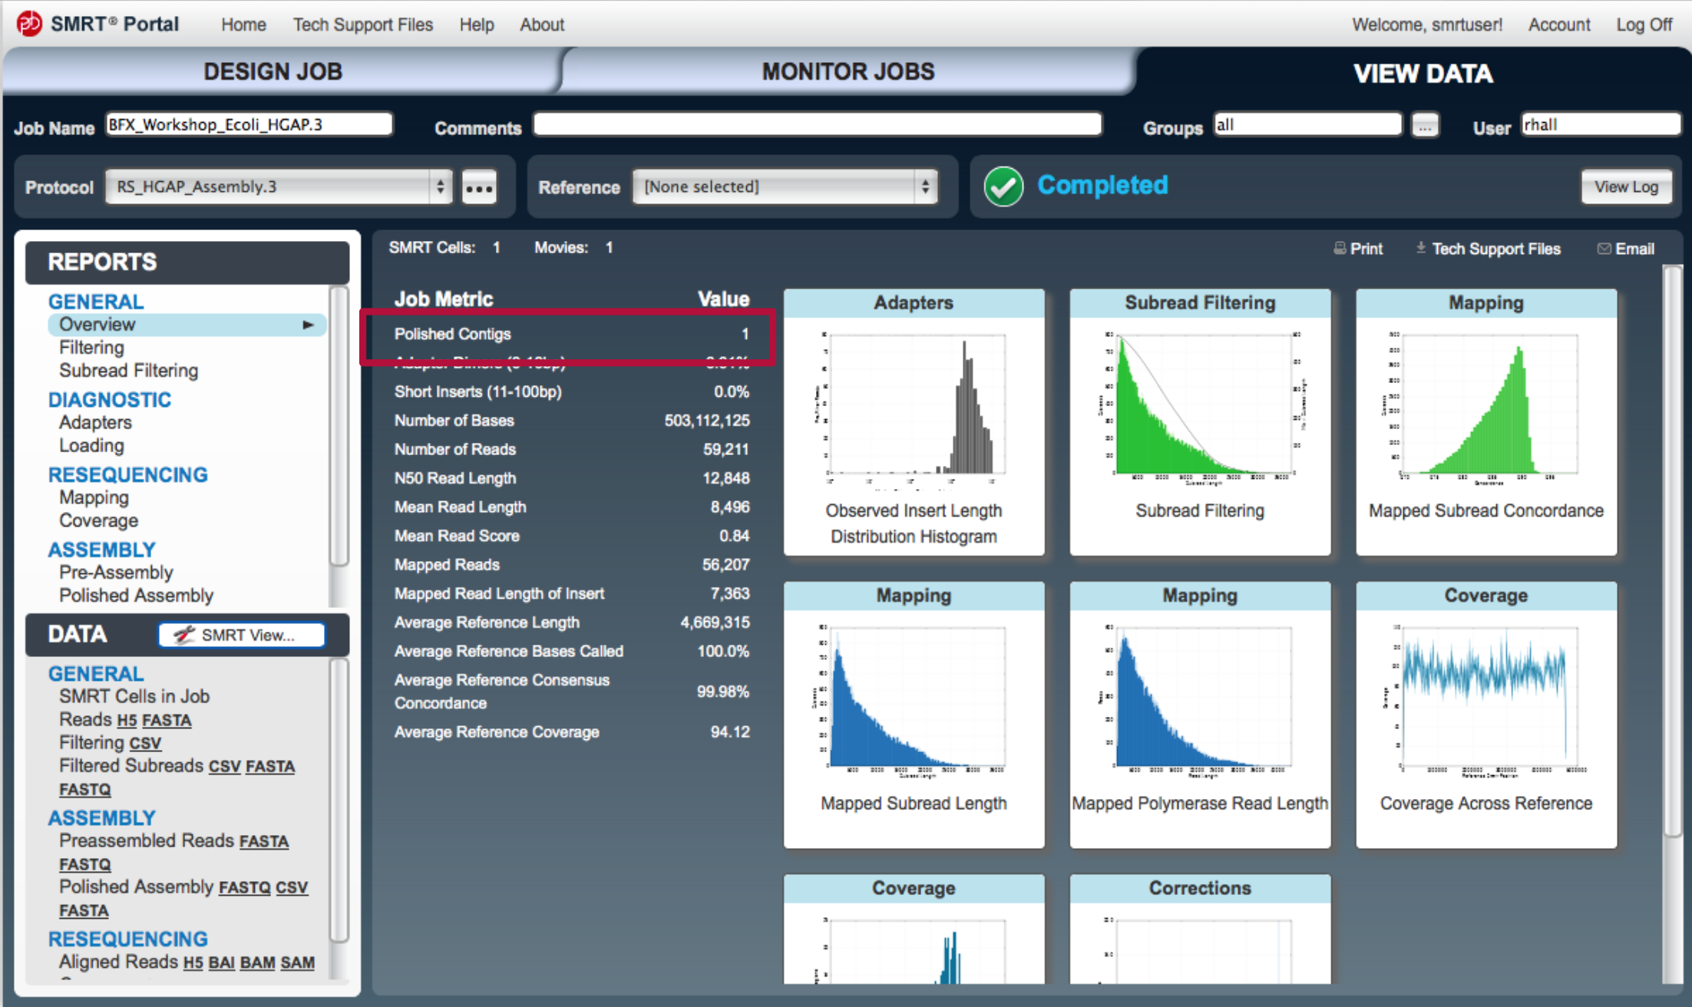
HGAP

Slide 27
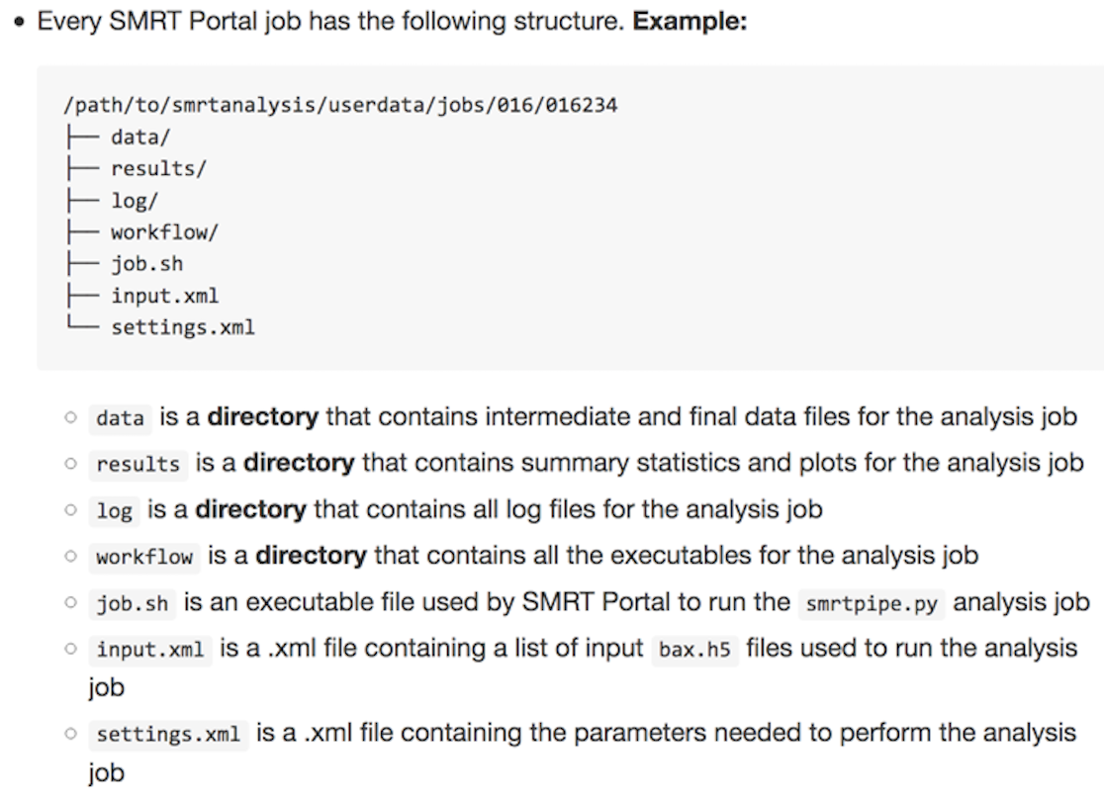
HGAP
Running HGAP (Command line)
Install SMRT Analysis software
Make a HGAP assembly job using the SMRT portal and save.
Save the settings.xml file as HGAP_protocol.xml

Slide 28
HGAP
Running HGAP (Command line) cont’d.
Modify Genome size in HGAP_protocol.xml
<param name=“genomeSize” label=“Genome Size (bp)”> <value>5000000</value>
Source the SMRT analysis environment
source /path/to/smrtanalysis/install/smrtanalysis_2.3.0.140936/etc/setup.sh
Add the full paths of your raw data (*.bax.h5) into an input.fofn
find <data_dir> -name “*.bax.h5” > input.fofn
Convert the input.fofn to an input.xml
fofnToSmrtpipeInput.py input.fofn > input.xml
Run SMRT pipe using the protocol and input xmls.
smrtpipe.py --params=HGAP_protocol.xml xml:input.xml
Results are found in index.html in the working directory
Assembly is in data/polished_assembly.fastq.gz

Slide 29
HGAP
#! /bin/bash
#SBATCH -A <your uppmax project>
#SBATCH -p core
#SBATCH -n 8
#SBATCH -t 1-00:00:00
#SBATCH -J run_smrt_assembly
#SBATCH -e run_smrt_assembly-%j.out
#SBATCH -o run_smrt_assembly-%j.out
module load bioinfo-tools SMRT/2.3.0
WORK_DIR=$SNIC_TMP/smrt_assembly_$(date +%Y_%m_%d-%H.%M)
PROJ_DIR=$PWD
PROTOCOL_XML=$PROJ_DIR/Settings/HGAP_protocol.xml
DATA_DIR=${PROJ_DIR}/00_RawData # Use full path
GENOME_SIZE=5000000
# Modify Protocol xml to the correct genome size
perl -0777 -i.original -pe "s/<param name=\"genomeSize\" label=\"Genome Size \(bp\)\">\n\s+<value>\d+<\/value>/<param name=\"genomeSize\" label=\"Genome Size (bp)\">\n\t\t<value>$GENOME_SIZE<\/value>/igs" $PROTOCOL_XML
# Activate SMRT Analysis environment
source $SMRT_SETUP_SCRIPT
mkdir -p $WORK_DIR; cd $WORK_DIR
# Make input file
find ${DATA_DIR} -name "*.bax.h5" > input.fofn
fofnToSmrtpipeInput.py input.fofn > input.xml
smrtpipe.py --params=$PROTOCOL_XML xml:input.xml
cd $PROJ_DIR; rsync -av $WORK_DIR .

Slide 30
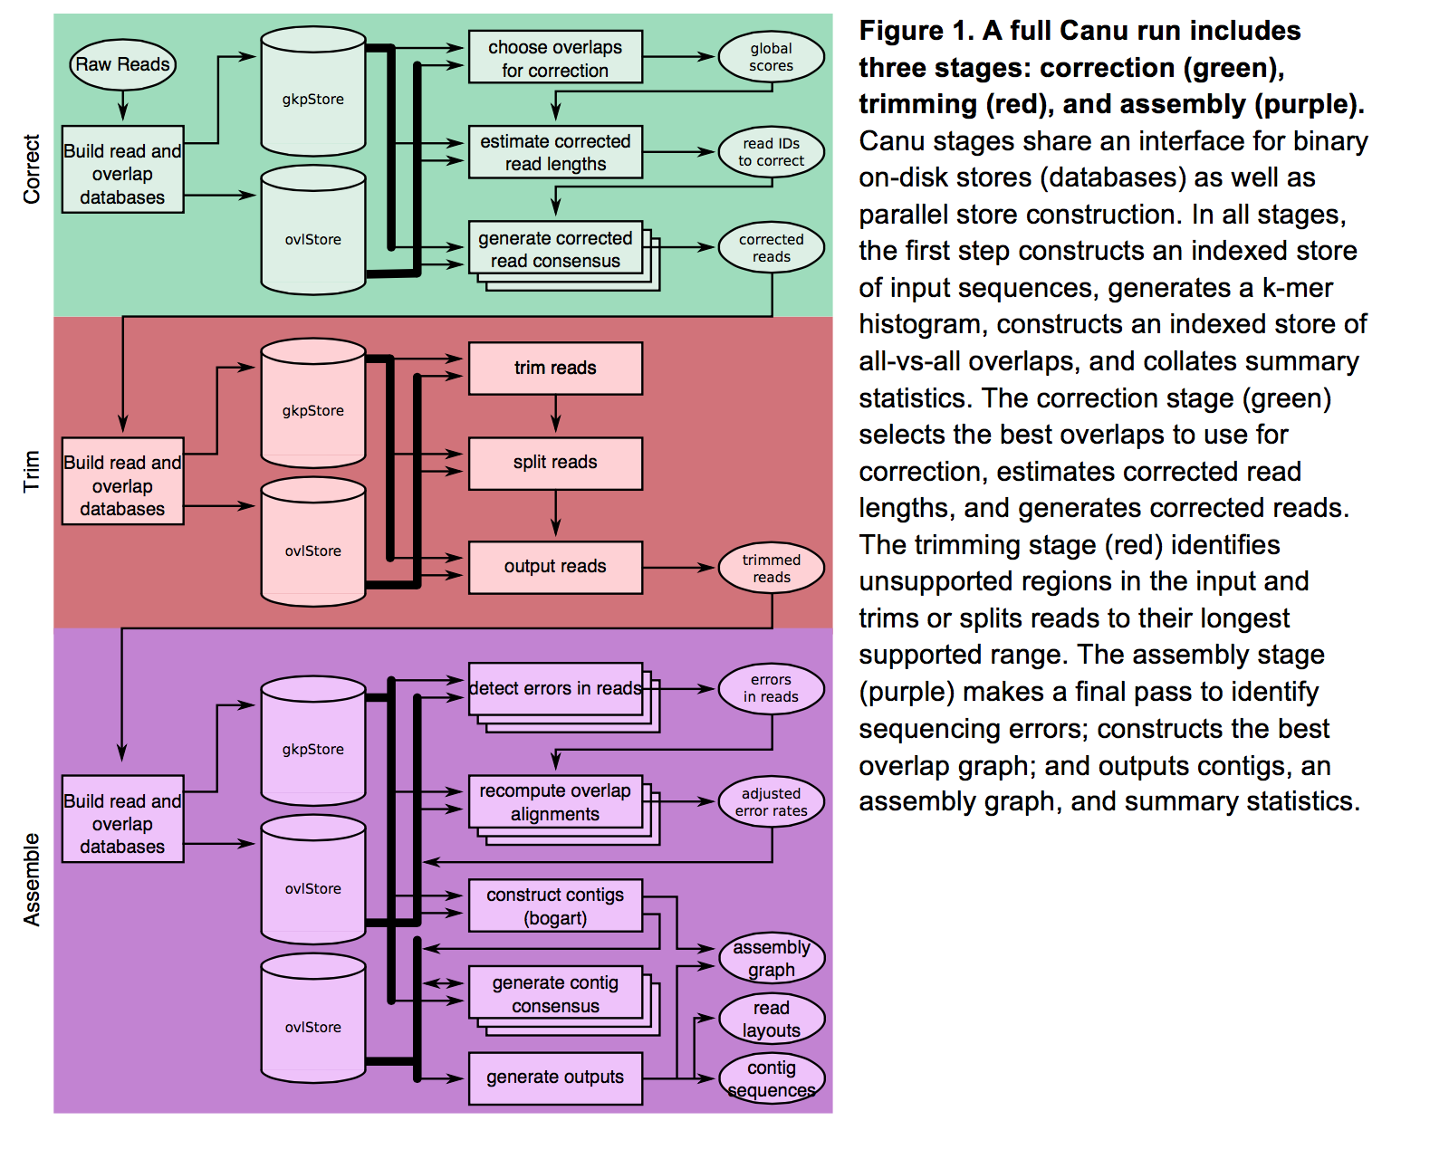
Canu
Koren et al. 2016. BioRxiv

Slide 31
Canu
Running Canu
Can auto-detect cluster settings (not recommended for milou)
Run canu on a node
useGrid=false
maxThreads=$NPROCS
canu -p <file_prefix> -d <out_dir> genomeSize=“18m” maxThreads=24 useGrid=false -pacbio-raw <filtered_subreads.fastq.gz>
Results
Sequence is in file_prefix.contigs.fasta
Assembly graph is in file_prefix.gfa

Slide 32
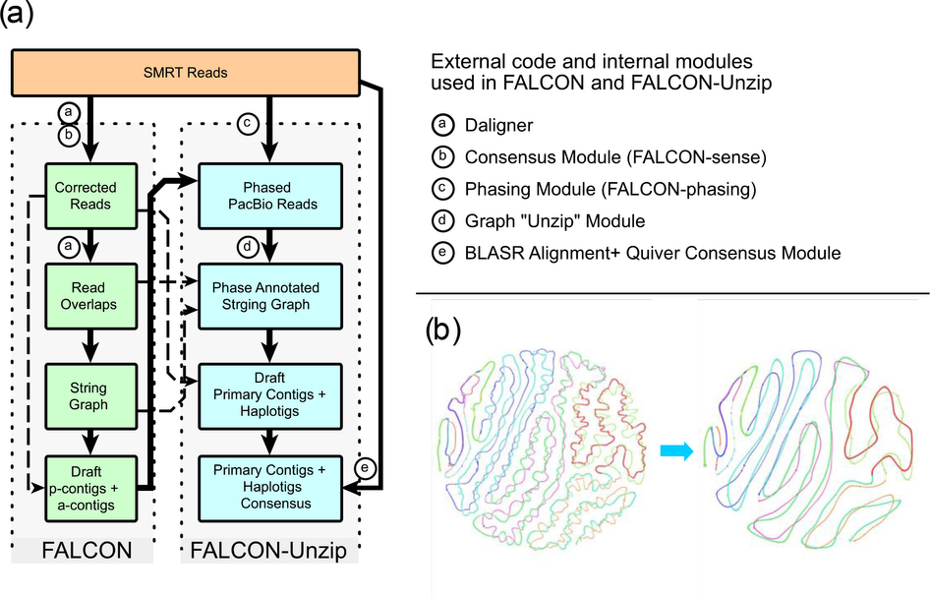
Falcon
Chin et al. 2016. Nature Methods

Slide 33
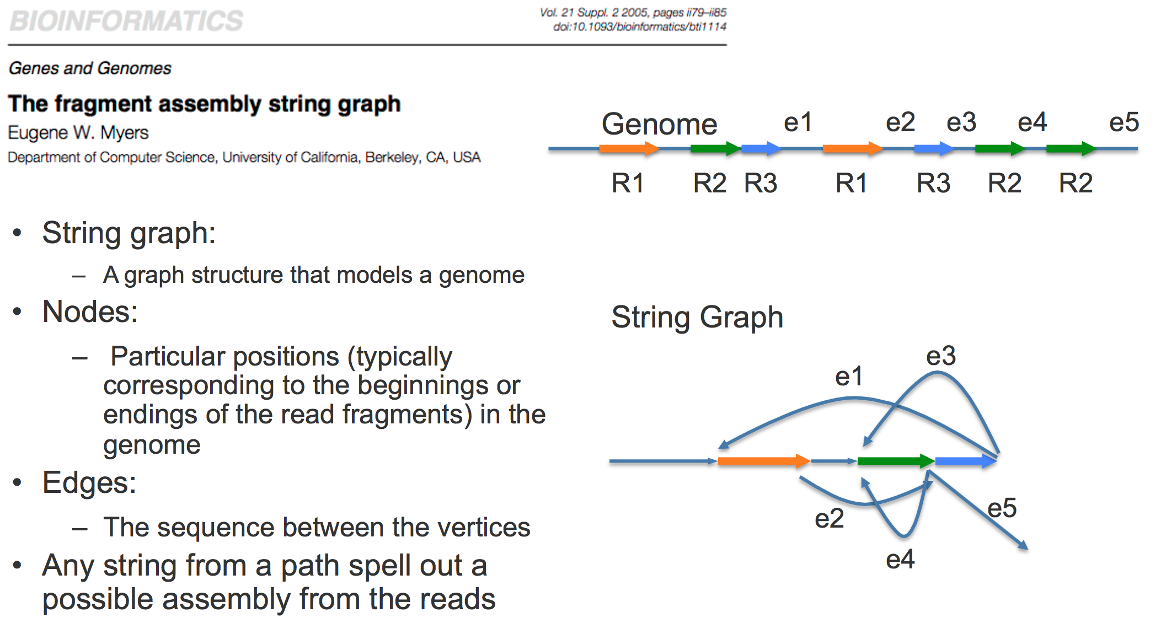
Falcon
Slides from Jason Chin:Diploid_Assembly_V1106_SpeakerDeck.pdf

Slide 34
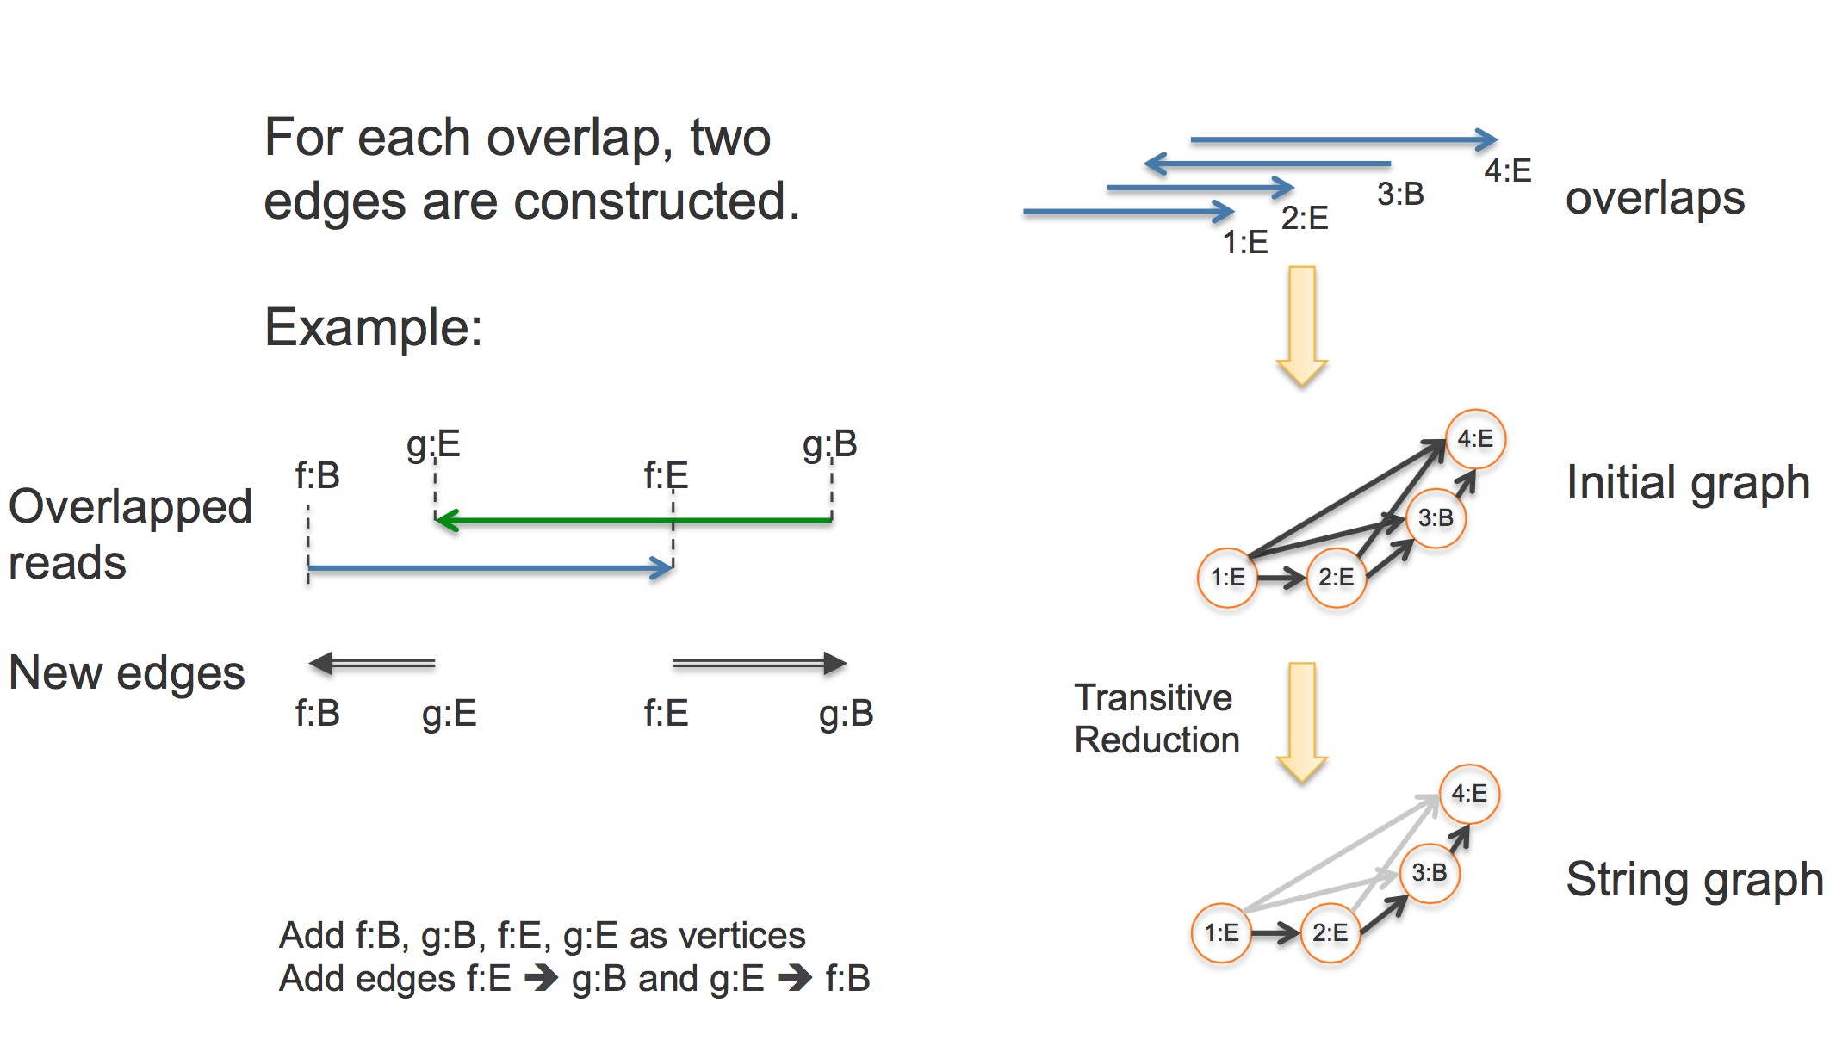
Falcon

Slide 35
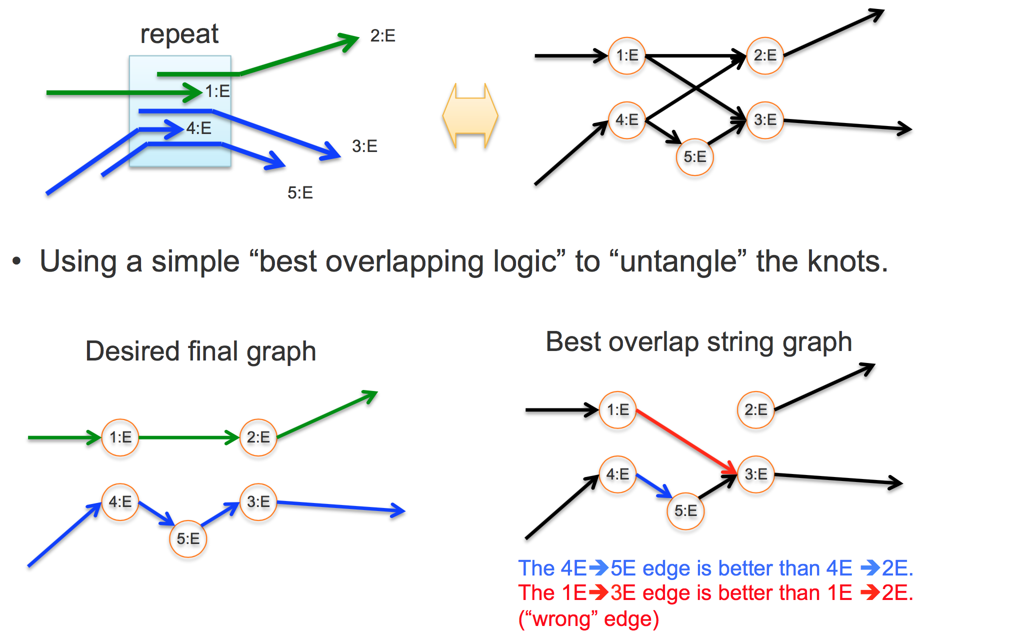
Falcon

Slide 36
Falcon
Wrong edge selected because of greater overlap with other read

Slide 37
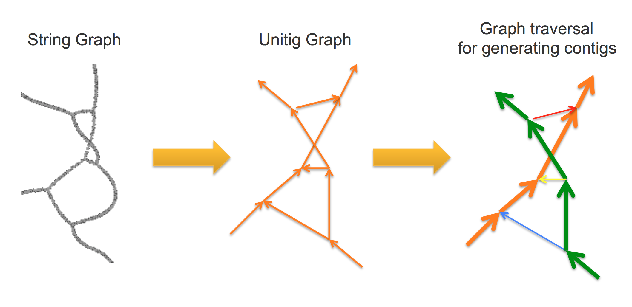
Falcon

Slide 38
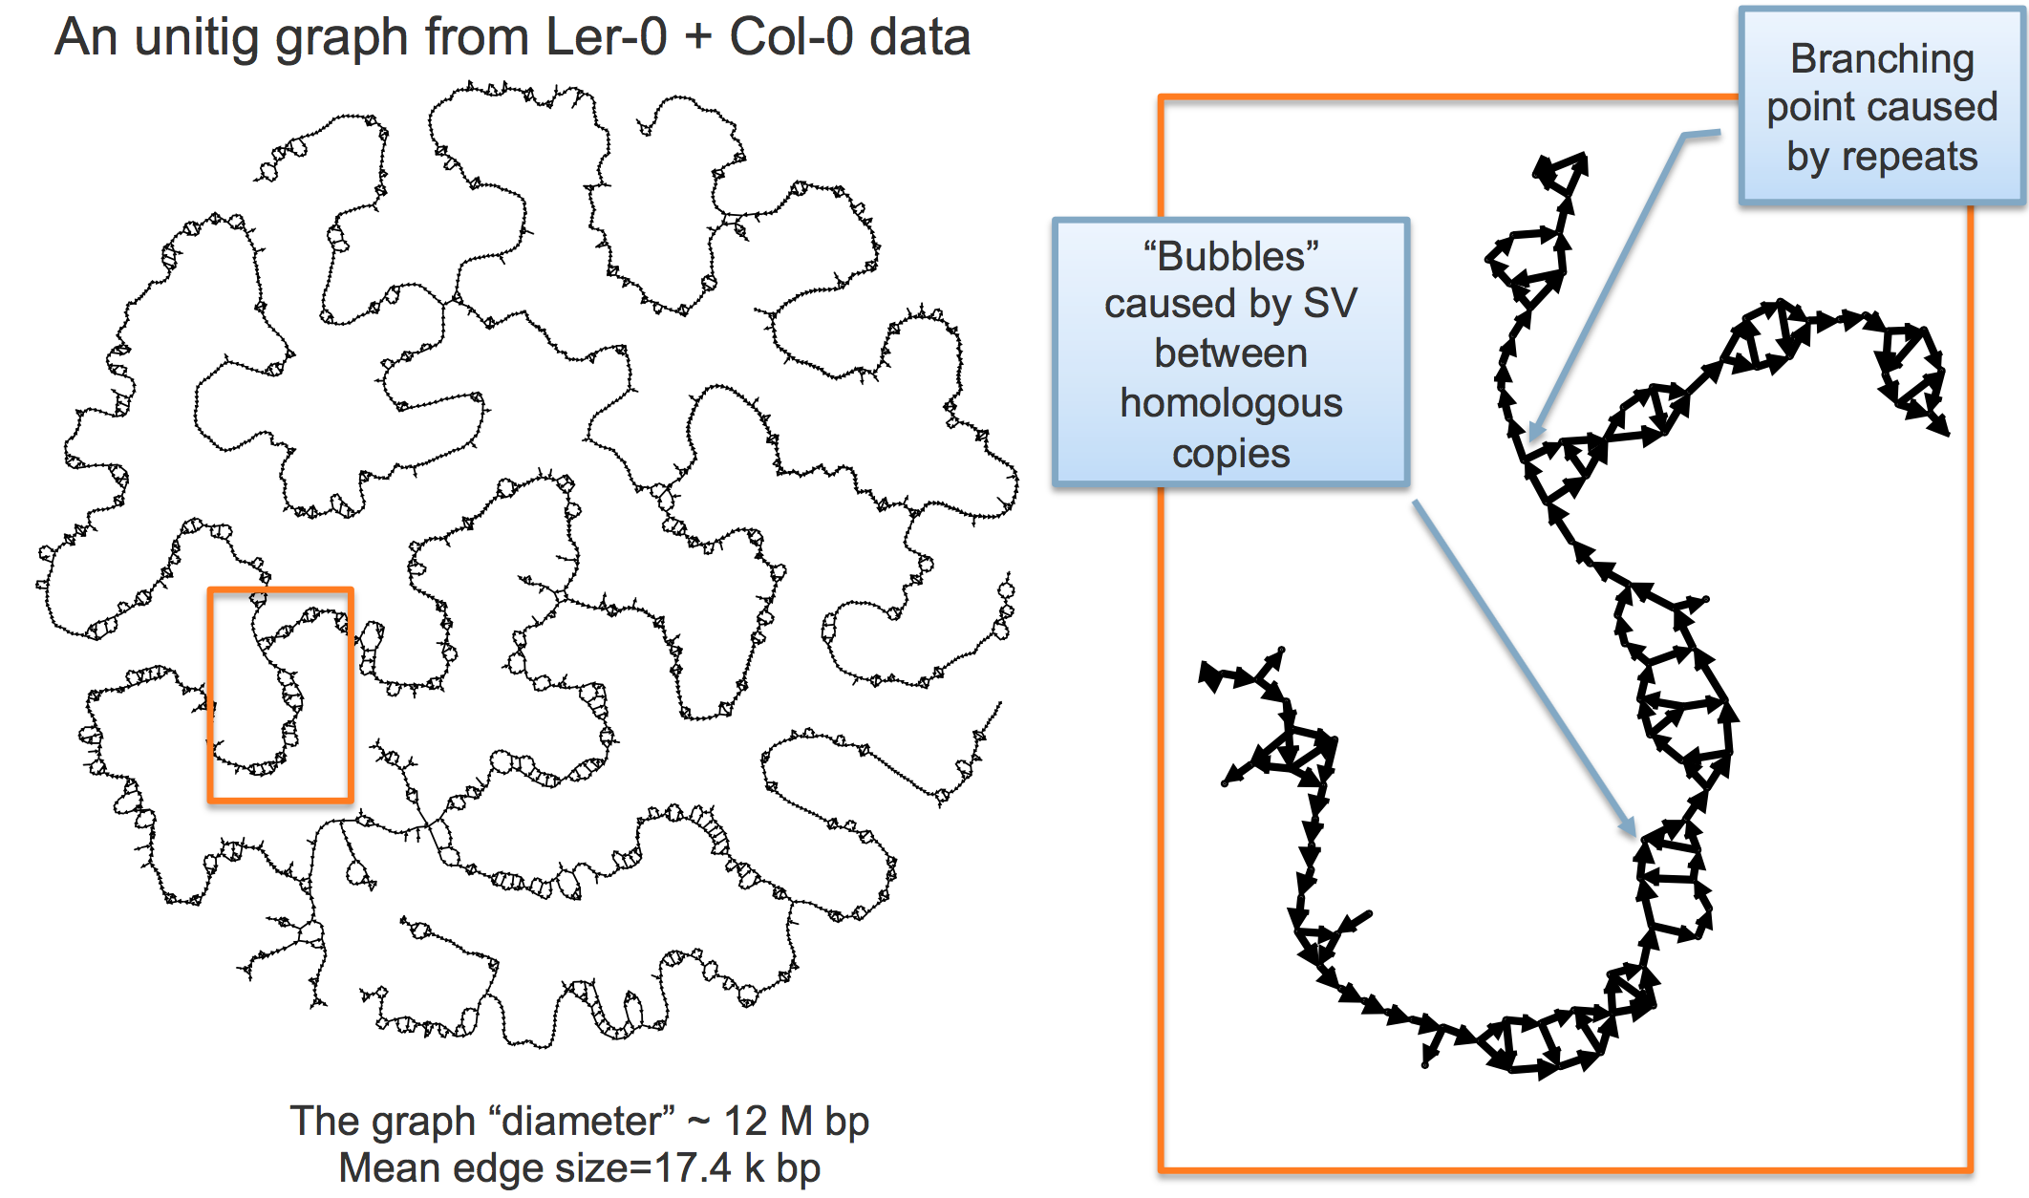
Falcon

Slide 39
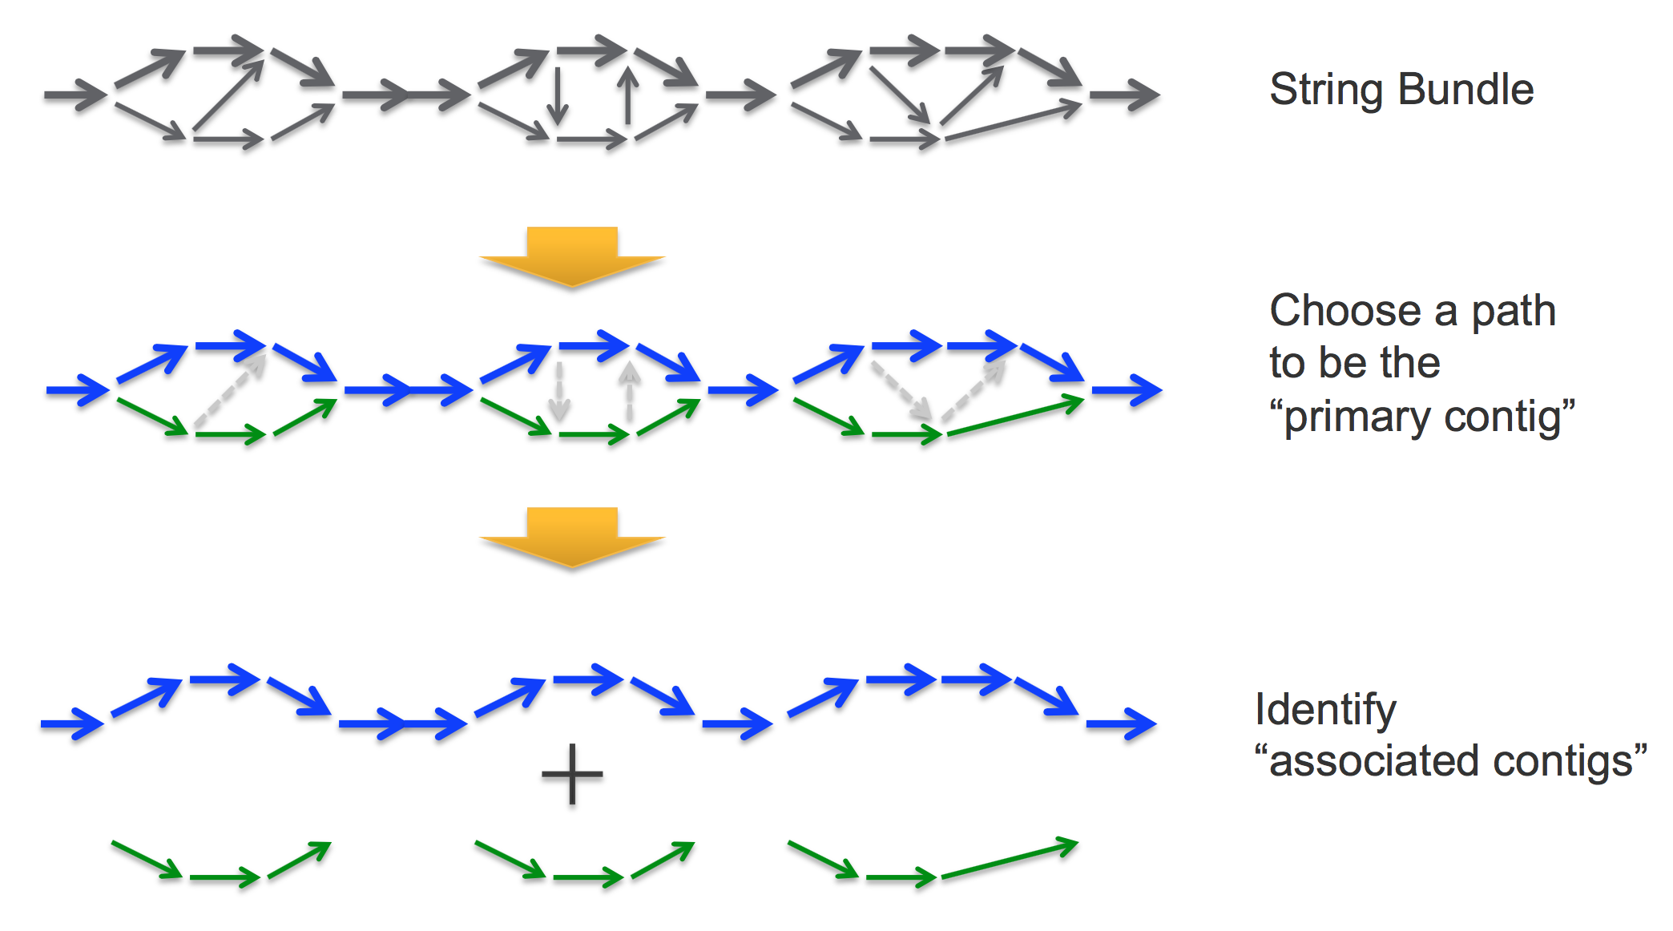
Falcon

Slide 40
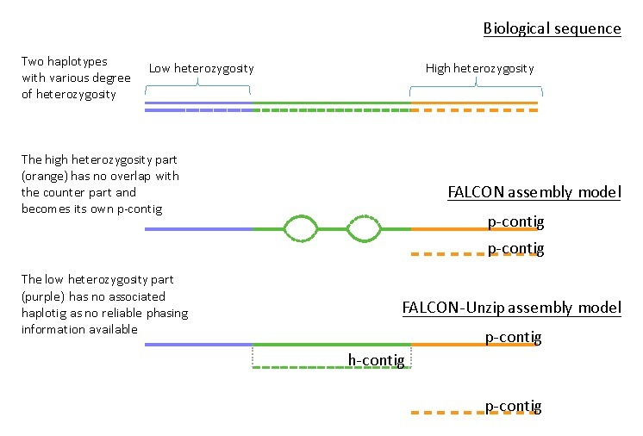
Falcon

Slide 41
Falcon
Running Falcon
Make a configuration file
Can use SGE queuing manager
Run locally on a node
Separate filtered subreads into separate fasta’s for each movie
zcat *.fastq.gz | seqtk seq -l 5000 -A - | awk ‘BEGIN { RS=“>”; FS=“/” } { print “>”substr($0,1,length($0)-1) > $1”.fasta” }‘
Make an input fofn
/bin/ls -1 *.fasta > input.fofn
Run Falcon
fc_run.py falcon.cfg

Slide 42
Falcon
Notes from the author
Falcon is limited by file i/o capabilities
Lustre file system recommended
NFS can handle 3-5 concurrent jobs during pre-assembly
Highly repetitive genomes require quadratically more storage space
Falcon scales quadratically
All-by-all comparison of raw subreads, with matches written to disk

Slide 43
Falcon
The Falcon config file (parameter rich - explanation in the exercises)
[General]
jobtype = local # other values sge, slurm
input_fofn = input.fofn
input_type = raw # uncorrected reads
#input_type = preads # falcon corrected reads
# The length cutoff used for seed reads used in initial mapping - these make the corrected reads
length_cutoff = 12000 # use longest 30X coverage
# The length cutoff used for seed reads used for pre-assembly - the min length of corrected reads
length_cutoff_pr = 12000 # 0-5000 lower than above

Slide 44
Miniasm and Racon
No read correction step
Miniasm implements Overlap - Layout, Racon implements Consensus
# Overlap minimap/minimap -Sw5 -L100 -m0 -t8 reads.fq reads.fq | \
gzip -1 > reads.paf.gz # Layout miniasm/miniasm -f reads.fq reads.paf.gz > contigs.gfa # Get fasta awk ‘/^S/{print “>”++seq”\n”$3}’ contigs.gfa > contigs.fasta # Consensus
miniasm/minimap -t 16 contigs.fasta reads.fq | \
racon -t 16 reads.fq - contigs.fasta consensus_contigs.fasta

Slide 45
Alternative PacBio Assemblers
ABruijn
Uncorrected overlap assembly of long read sequences followed by polishing
https://github.com/fenderglass/ABruijn
Ra
Uncorrected overlap assembly of long read sequences
https://github.com/mariokostelac/ra-integrate
ARacon
Combination of GraphMap + Miniasm + Racon
https://github.com/isovic/aracon
Hinge
Read filtering (but no correction) followed by overlap assembly of long read sequences
https://github.com/fxia22/HINGE
SMARTdenovo
Uncorrected overlap assembly of long read sequences
https://github.com/ruanjue/smartdenovo

Slide 46
Preliminary Assembly Diagnostics
Assembly Size
Assemblathon Script (https://github.com/KorfLab/Assemblathon)
Quast
Number of scaffolds 556
Total size of scaffolds 31318563
Longest scaffold 447934
Shortest scaffold 8580
Number of scaffolds > 1K nt 556 100.0%
Number of scaffolds > 10K nt 555 99.8%
Number of scaffolds > 100K nt 38 6.8%
Number of scaffolds > 1M nt 0 0.0%
Number of scaffolds > 10M nt 0 0.0%
Mean scaffold size 56328
Median scaffold size 43995
N50 scaffold length 60037
L50 scaffold count 152
Expected genome size

Slide 47
Preliminary Assembly Diagnostics
Corrected Read Coverage
What happened in the correction process
High coverage? Use the ~100X longest subreads
-- Found 87386 reads.
-- Found 1654383605 bases (45.95 times coverage).
--
-- Read length histogram (one '*' equals 265.11 reads):
-- 0 999 0
-- 1000 1999 0
-- 2000 2999 0
-- 3000 3999 0
-- 4000 4999 0
-- 5000 5999 0
-- 6000 6999 0
-- 7000 7999 0
-- 8000 8999 0
-- 9000 9999 0
-- 10000 10999 0
-- 11000 11999 0
-- 12000 12999 0
-- 13000 13999 0
-- 14000 14999 0
-- 15000 15999 18558 **********************************************************************
-- 16000 16999 15099 ********************************************************
-- 17000 17999 11974 *********************************************
-- 18000 18999 9486 ***********************************
-- 19000 19999 7344 ***************************
-- 20000 20999 5652 *********************
-- 21000 21999 4328 ****************
-- 22000 22999 3516 *************
-- 23000 23999 2725 **********
-- 24000 24999 2057 *******
-- 25000 25999 1672 ******
-- 26000 26999 1243 ****
-- 27000 27999 920 ***
-- 28000 28999 735 **
-- 29000 29999 541 **
-- 30000 30999 414 *
-- 31000 31999 324 *

Slide 48
Preliminary Assembly Diagnostics
Falcon: DBstats 1-preads_ovl/preads.db
Focus on % Bases column (multiply by read coverage to find cutoff).
Statistics for all wells of length 500 bases or more
12,915 reads out of 13,124 ( 98.4%)
116,202,931 base pairs out of 116,263,784 ( 99.9%)
8,997 average read length
6,983 standard deviation
Base composition: 0.249(A) 0.239(C) 0.258(G) 0.255(T)
Distribution of Read Lengths (Bin size = 1,000)
Bin: Count % Reads % Bases Average
42,000: 1 0.0 0.0 42279
41,000: 2 0.0 0.1 41631
... (more bin values) ... 3,000: 1,065 75.5 95.0 11317
2,000: 1,328 85.8 97.9 10259
1,000: 1,444 97.0 99.7 9251
0: 387 100.0 100.0 8997
Find the row that corresponds to 30x coverage.
Total bases/ Est. genome size = Total coverage.
30x / Total coverage = % bases
Bin corresponding to 30x is the cutoff length.

Slide 49
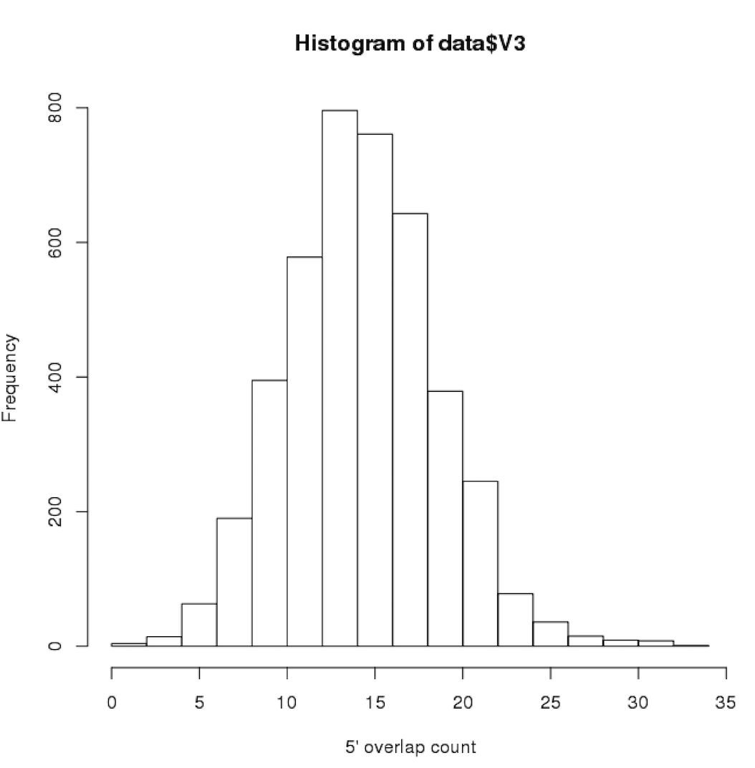
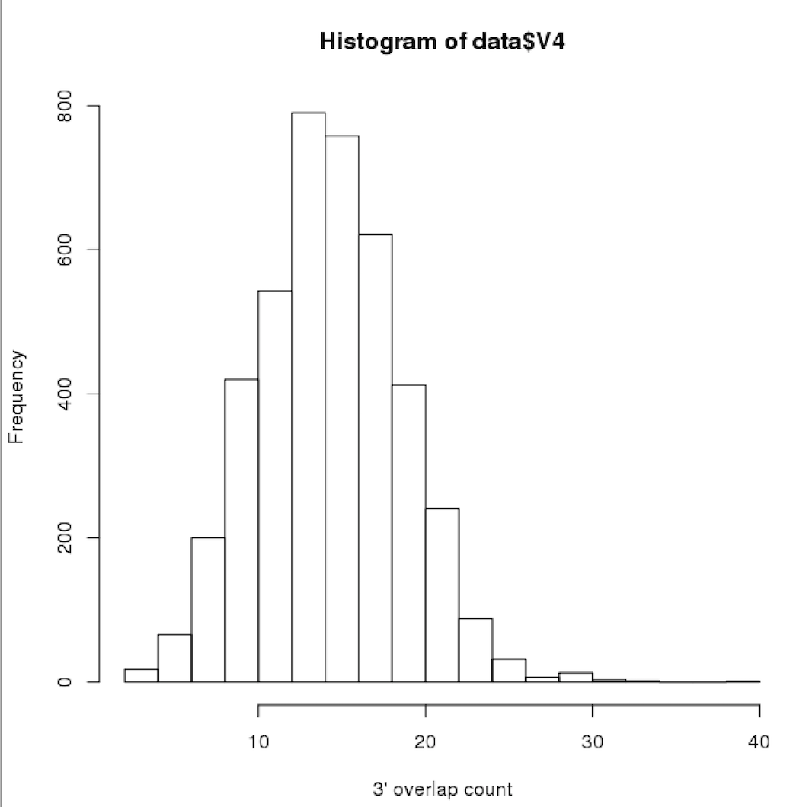
Preliminary Assembly Diagnostics
Falcon: Overlap statistics
cd 1-preads_ovl/ ; fc_ovlp_stats --fofn merge-gather/las.fofn > ovlp_stats.txt
$ R > data <- read.table(“ovlp_stats.txt”) > hist(data$V3,xlab=“5’ overlap”)
> hist(data$V4,xlab=“3’ overlap”)

Slide 50
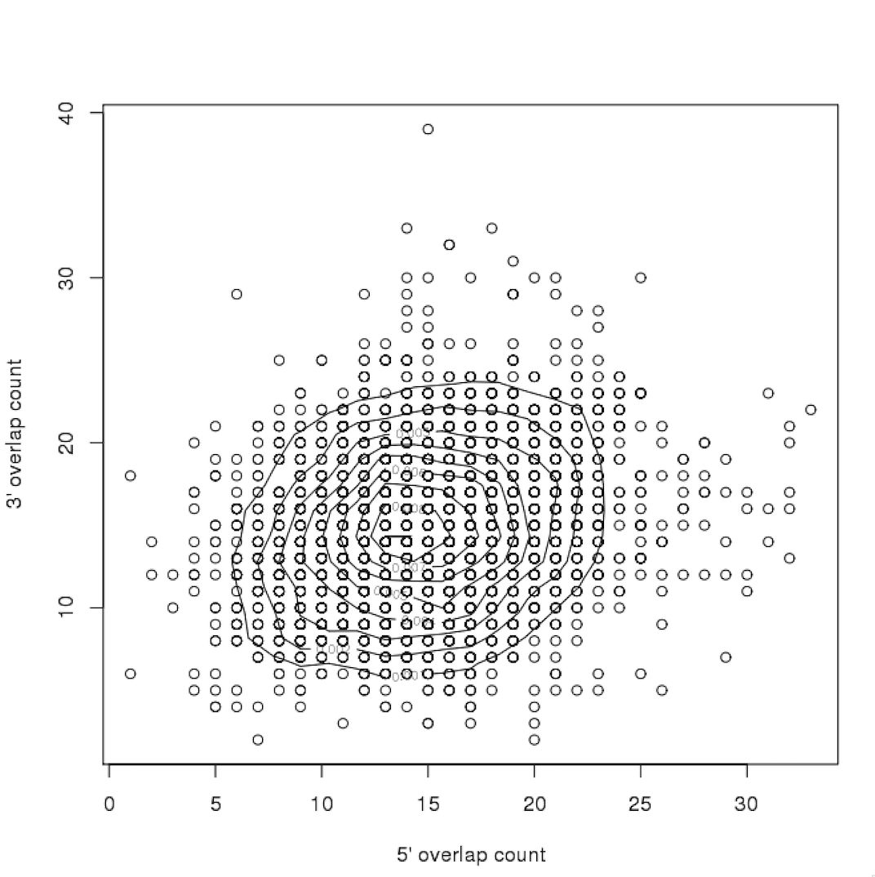
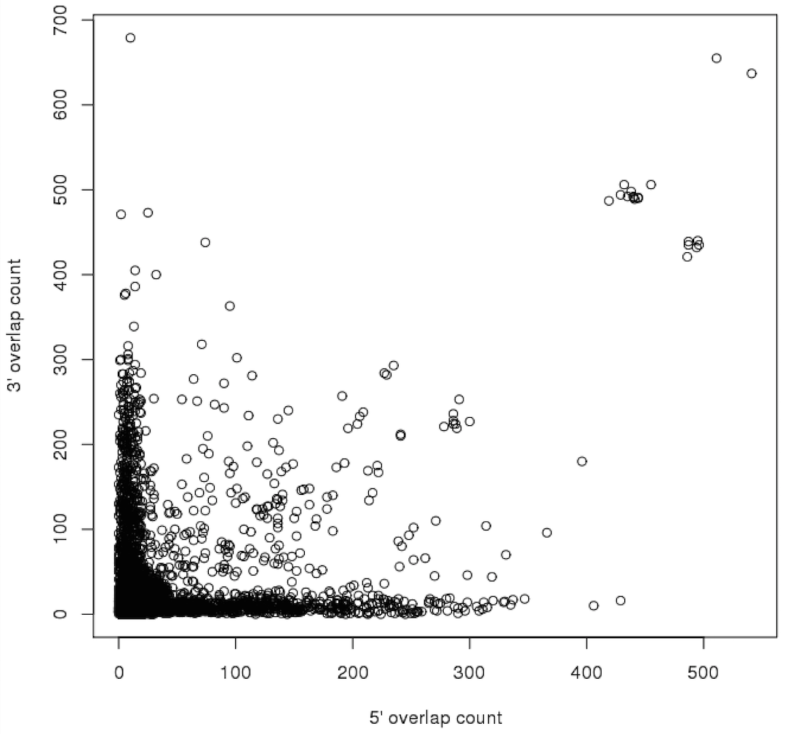
Preliminary Assembly Diagnostics
Falcon: Overlap statistics
$ R
> library(MASS)
> data <- read.table(“ovlp_stats.txt”)
> plot(data$V3,data$v4)
> z <- kde2d(data$V3,data$v4)
> contour(z,add=TRUE)
Central density and symmetry along x=y is expected.

Slide 51
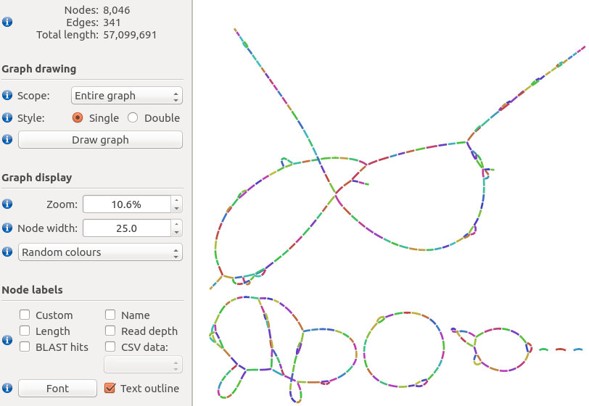
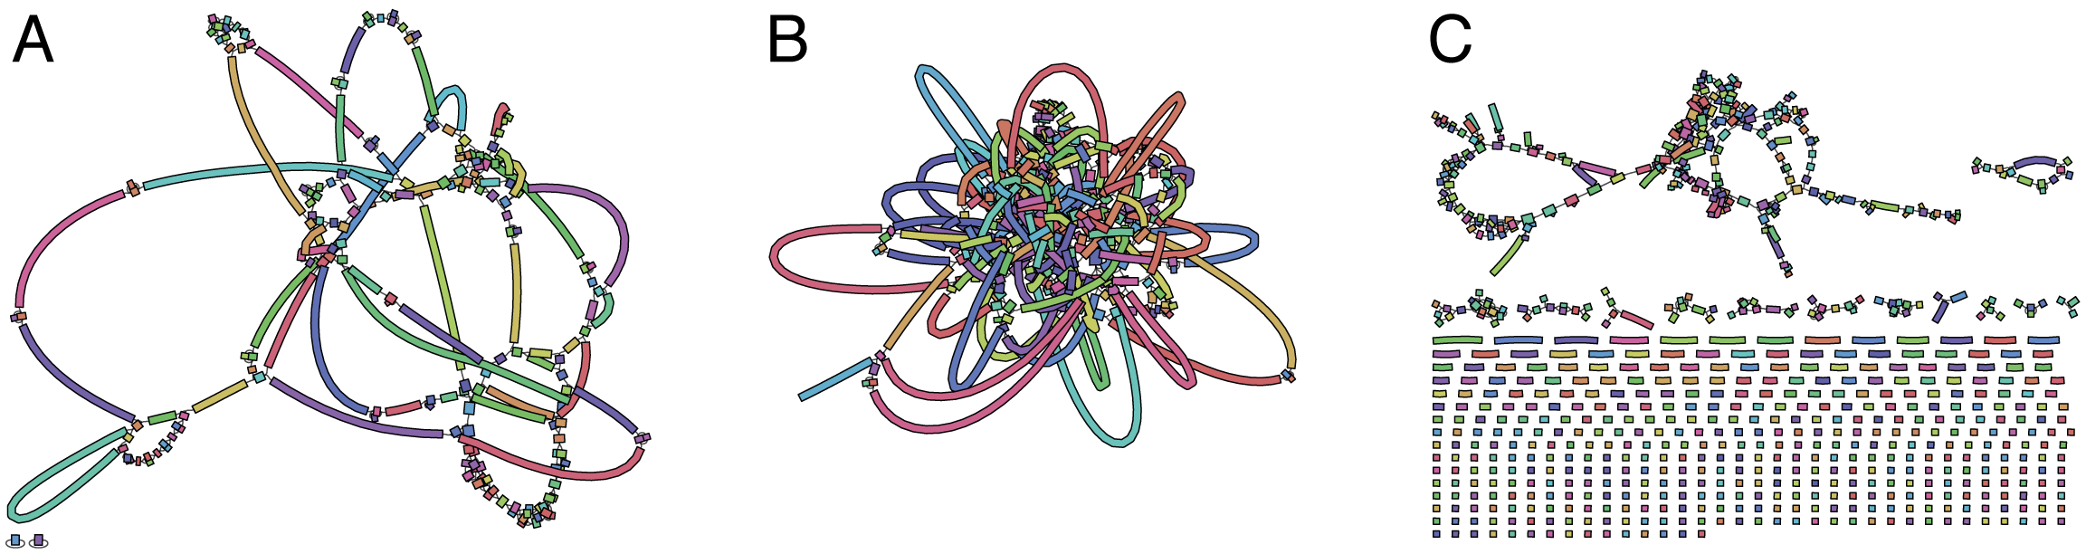
Preliminary Assembly Diagnostics
Assembly Graph
Check connectedness of contigs
Is longer range information needed?
Higher quality sequence material
BioNano
Chicago / Dovetail
Good
OK
Bad

Slide 52
Polishing assemblies
Draft assemblies still contain many InDel and base substitution errors.
Correction using Quiver / Arrow and PacBio reads

Slide 53
Polishing assemblies
In the SMRT portal select a protocol that includes the following modules
P_Filter
P_Mapping
P_GenomicConsensus
RS_Resequencing
RS_BridgeMapper
P_BridgeMapper
To run via SMRT pipe
Copy the settings.xml of the dummy job
Make the draft assembly a reference using ReferenceUploader
Change reference value in settings.xml
Run

Slide 54
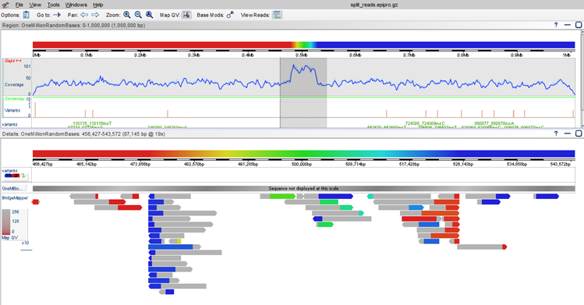
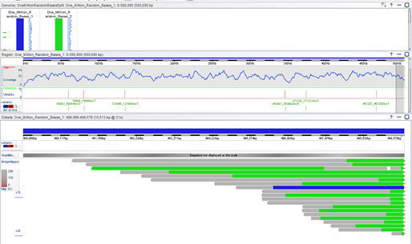
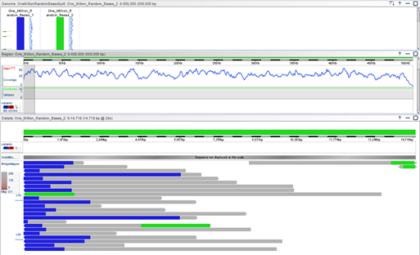
Polishing assemblies
Bridge Mapper results opened with SMRTview

Slide 55

Polishing assemblies
Draft assemblies still contain many InDel and base substitution errors.
Correction using Nanopolish and nanopore reads
Jared Simpson: AGBT presentation

Slide 56
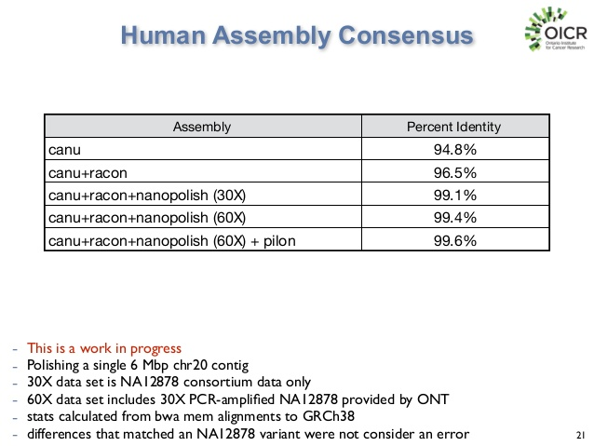
Polishing assemblies
Jared Simpson: AGBT 2016 Presentation

Slide 57
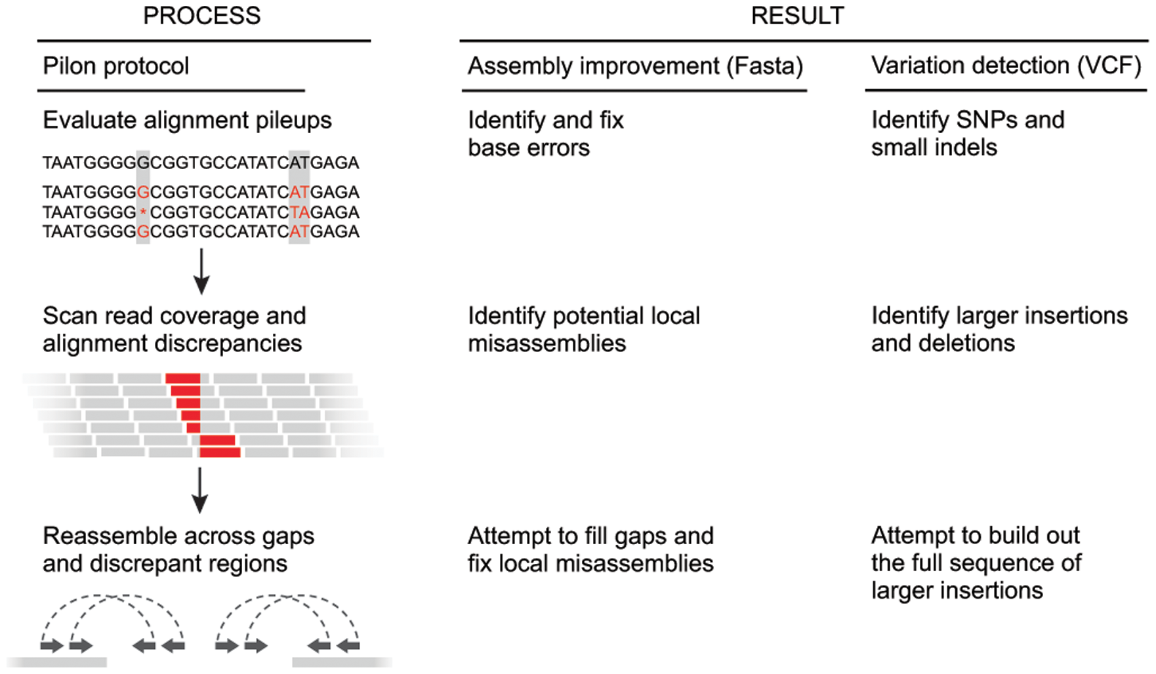
Polishing assemblies
Assembly Polishing
Can also be performed using Pilon and Illumina reads
Walker et al. 2014. PLOS One

Slide 58
Summary
Long read sequencing is very dependent on sample DNA quality
The longest reads are targeted for correction
Correction with Illumina only does part of the read correction job
Check basic stats
Use the assembler output to diagnose major issues.
Select your best assemblies
Polish!
Assess correctness.

